Slide 1
Living Stronger than Cancer:
Building an ecosystem that combines human touch and digital tools to improve the quality of survivorship
By Sharon Lee

Slide 2
Rooted on Insights : Survivors 2015
Directory of resources
List of hospitals
Financial avenues
Palliative care
Home nursing
Support groups
“What would have been important to know?”
Practical help
Preparing for the hospital
Patients’ rights
Notes:
At the ideation stage of the digital support process, one of the key task was to create a knowledge base that is the same for CIS, mobile app and website. Survivors’ input is important as needed to contextualize information to the Malaysian culture and situation. A discussion among survivors were conducted and we found 3 important areas to include / contextualize in the knowledge base; practical help, preparing for the hospital and patient’s rights. The discussion also points to the lack of knowledge and information with regards to support available, hence the Directory of Resources was put together for the purpose.

Slide 3
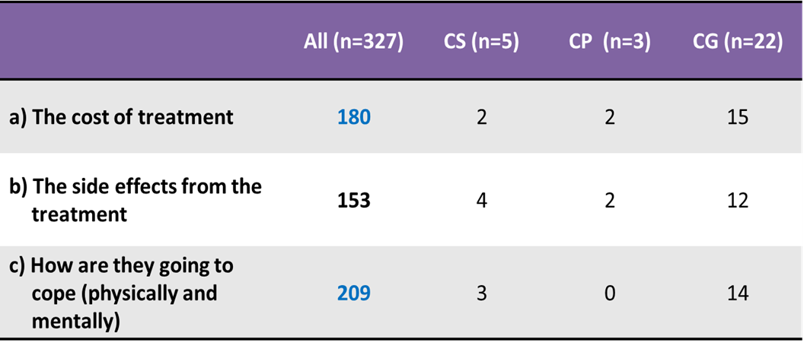
Rooted on insights: Community survey 2015 - 2017
Q: If you/your family member is diagnosed with cancer, what would be your top 2 concerns?
Notes:
On going data collection was also conducted to ensure we had the right information ready for our callers. Information are refreshed and included based on findings. We believe one of our key success factors is understanding what survivors and callers need.

Slide 4
Rooted on insights: Patients, Survivors, Caregivers: 2018
Empathy
Approachability
Fast & accurate
Languages
4 main languages
Experienced in onco. & BMT
Information knowledgebase
Genuine desire to make a difference
Check list
The flex to speak to different levels of the community
Self service technology
Communication skills :
tone & manner
Cultural sensitivity
Notes:
This is the latest study done on survivors and caregivers on what they expect from support providers. Empathy and approachability of the person providing support is crucial and so is the importance of fast and accurate information to help them make decisions.
The tick signs on the left side (red) are characteristics that our CIS nurses possess and were the exact hiring criteria we had, in order to meet the diversity of our community; language, gentle, education levels, income levels.
This exercise also impresses upon us to now pay more attention to cultural sensitivities especially the Malay community that makes up 67% of the population. Demographically, they are skewed middle to lower income, have lower education level, Muslims and women are submissive to their husband and / or father.

Slide 5
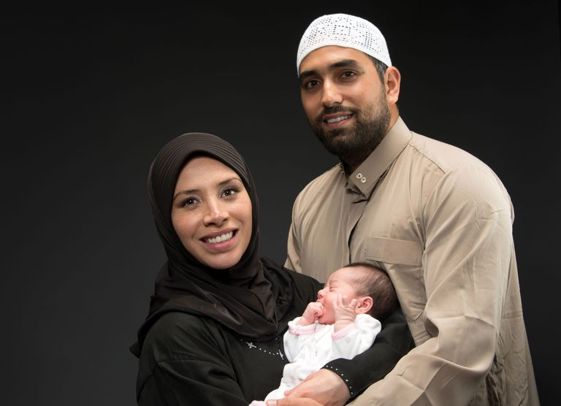
Next level challenge: Cultural sensitivity
Appealing to the majority
Objective : to improve survivorship
The Malay community makes up 67% of the population.
Lower to mid level income.
Goes to the public hospitals but with reported high drop out rate.
Strong inclination towards alternative / herbal remedies.
Male centric and submissive to the wishes of fathers/spouse, often agreeing to alternative remedies versus surgery.
Prefer to discuss with fellow Muslim.
Target the Malay community with a support ecosystem
Set up a task force to tackle inclination towards alternative remedies in the community
NCSM
Mental Health
Sociologist
Psychologist
Counsellor
Government
Ministry of Health
Women Development
Doctors & Nurses
Religious leaders
CA survivors & Spouse
Notes:
The foundation work has been laid with the introduction of CIS, mobile app and website. The next level challenge is being able to find the way to convince the Malay community to seek conventional treatment rather than alternative treatment (to protect their womanhood and marriage) will be a big plus in reducing CA death among the biggest population in Malaysia. The idea is to set up a task force to unlock this prevailing unprofitable culturally based practice.

Slide 6
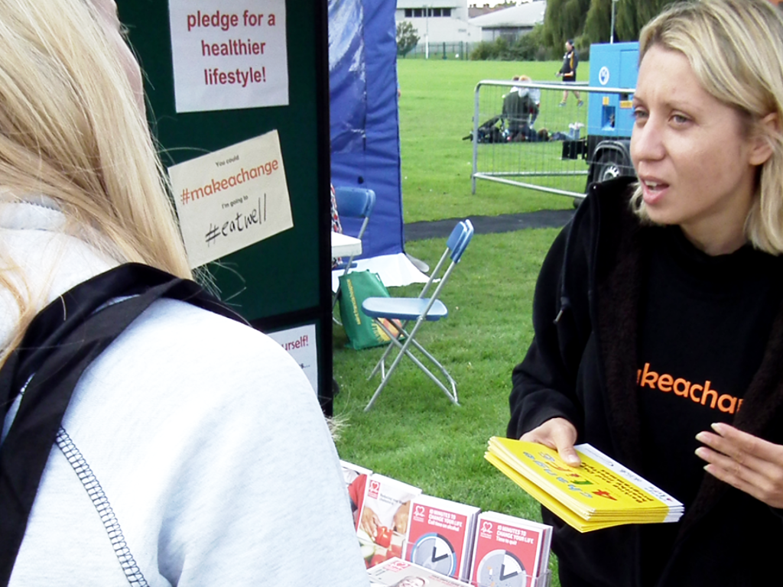
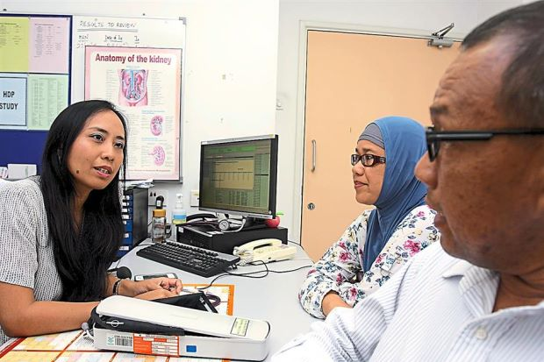
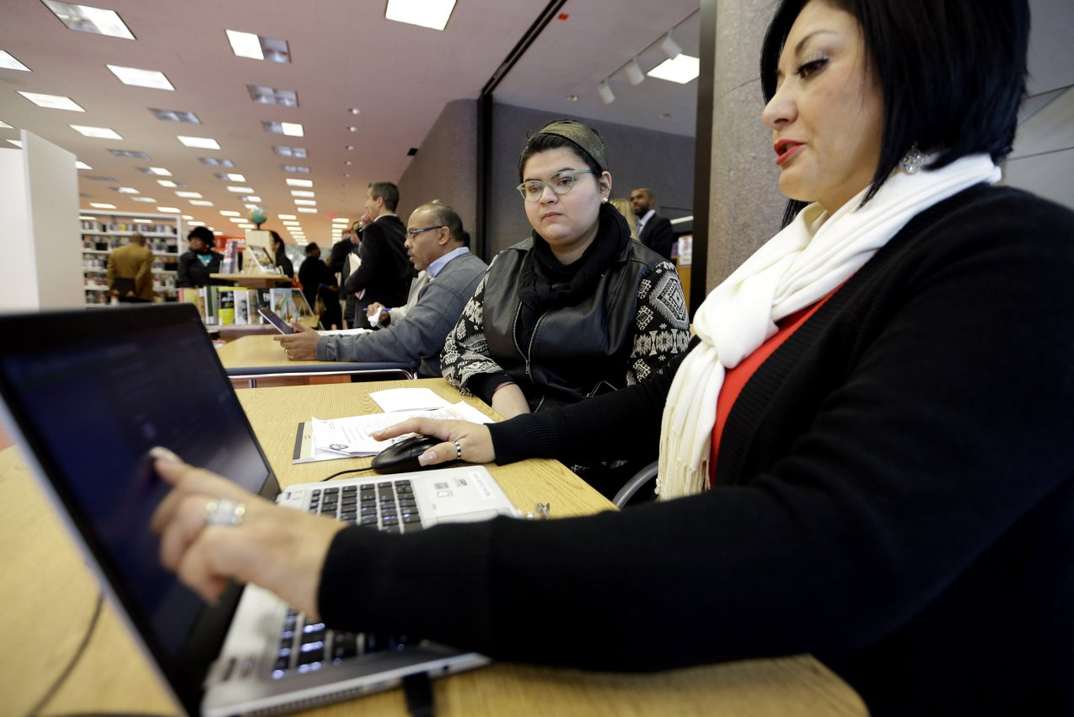
The support ecosystem
CIS
Emails
Chat forums
Websites
Wellness Centre
Support group
NCSM Help Desk
Patients into hospitals
Data in PNS
Track journey to closure
Care Navigator & Interactive System
Community Health Ambassadors
Notes:
In summary, a wholesome and strong support ecosystem encompasses man and machine; digital platforms and the human touch.
Next steps:
There are plans to train Community Health Ambassadors for education and improve screening uptake. These ambassadors direct patients to the hospitals with data of patients captured in the Patient Navigation System (PNS). NCSM’s Help Desk manned by Support Volunteers will introduce them to the various digital and not digital support care available.
Patients, Care Navigator and Help Desk should be able to access the PNS. Patients can use it to check appointments, and nurses plus Help Desk will use it for the purpose of managing reminder call and providing information and emotional support.

Slide 7
Learnings
Did well
Continuous improvement
Rooted on insights that leads to local content
Localizing content of existing knowledge base
Hiring for diversity & experience
4 major languages
Oncology experience
Excellent communication skills over the phone
Embrace technology
CIS provided an avenue for communication, helpful for an inhibitive community
5% of callers received deeper support from subsequent F2F counselling and wellbeing programmes
Review mobile app strategy as downloads are low. Does not command broad base interest.
Fizziness of digital tools – keeping it Top of mind
Knowledge bank – continuous addition / update of information
System & report automation
Quantifying the impact
Notes:
The mobile app had not been popular. We believe that this is due to the plethora of apps in every individuals’ phone, competing for memory space. We may review content to include tracking/ logging of appointments etc or target the mobile app for the HCP audience.

Slide 8
Thank you
National Cancer Society of Malaysia
sharonlee@cancer.org.my

