Slide 1
Multi-component approach to improving patient access to trials: the experience in Victoria, Australia
Christie Allan, Cancer Council Victoria (Australia)

Slide 2
Clinical trial activity in Victoria:
Recruitment into cancer clinical trials in Victoria is low – between 5% and 6% of all newly diagnosed cancer patients are recruited into a trial.
At any given time, there are between 200 and 300 treatment intervention trials open for cancer patients in Victoria.
Reasons why recruitment is low are multifaceted; patient access and awareness is a contributor.
Christie Allan, Cancer Council Victoria (Australia)
Notes:
Recruitment into cancer clinical trials in Victoria is low – between 5% and 6% of all newly diagnosed cancer patients are recruited into a trial. At any given time, there are between 200 and 300 treatment intervention trials open for cancer patients in Victoria – not taking into consideration duplicate counts of trials. Reasons why recruitment is low are multifaceted; patient access to trials is a contributor. In Victoria, common factors that restrict patient access include: broader awareness and understanding of clinical trials as a component of optimal cancer care (consumers and clinicians), the distance and cost of travelling to clinical trials (for people living in rural or regional parts of Victoria, in particular), a lack of unified referral and awareness of trials at different trial sites, site resourcing, limited data for measuring clinical trial activity and impact nationally and the increasing complexity of trial processes, including eligibility and consent.

Slide 3
Multi-component approach:
Improving patient access to trials
Building trial site capacity
Cancer Trials Management Scheme
Providing user friendly information and support
Victorian Cancer Trials Link
Learning from consumer experiences
Notes:
Cancer Council Victoria is an independent not for profit organisation in Victoria, Australia, that has a long history of supporting research in clinical trials. Since1988 Cancer Council has contributed around $20 million donor dollars through programs like the Cancer Trials Management Scheme. Leveraging and building on existing resources in the sector, Cancer Council are taking a multi-component approach to improve patient access to (and awareness of) clinical trials by building trial site capacity and providing access to consumer friendly information and support. Today I will be providing a quick overview about some of these initiatives, and the key learnings to take away from each. These include the Cancer Trials Management Scheme, Victorian Cancer Trials Link and a peer support program called Trial Connect.

Slide 4
Cancer Trials Management Scheme (CTMS)
Introduced in 1988 to fund on-site dedicated data managers, with the overarching aim of increasing trial participation.
Cancer Trials Management Scheme
Component | Aim | Funding | Distribution | End
Pay for data | Stratified funding model that supports the collection of clinical trial activity and recruitment data at Victorian clinical trial sites. | $200K distributed annually, awarded over 3 years. Site allocation is predetermined and based on prior activity, resourcing and recruitment. | 43 clinical trial sites. | 2018.
Competitive grants | Awards grants to researchers that propose innovative ways to improve patient access to clinical trials in Victoria. | $2.5M distributed between researchers, awarded over 3 years. | 4 grants awarded in 2017. | 2019.
Notes:
Originally established to fund onsite dedicated data managers, the aim of the Cancer Trials Management Scheme is to build the capacity of cancer clinical trials in Victoria and promote equitable access for patients.
The Scheme is implemented using a two-part funding model, in which Cancer Council Victoria provides financial support to 43 clinical trial sites in Victoria, spanning metropolitan, rural and regional areas. In return for allocated funding, we work with clinical trial sites to report annual clinical trial activity and recruitment data in Victoria, including the number and type of trials being conducted in the state. This data is also used as a way of providing information about recruiting trials to patients and clinicians in Victoria via the Victorian Cancer Trials Link (which I will get to). It facilitates greater awareness and referrals between trial sites and informs external stakeholder / government knowledge about clinical trials and the prioritisation of services in the state. Funding is pre-determined and based on site activity, recruitment and resourcing. There is no discrimination between pharmaceutically sponsored and non-sponsored trials, recognising that all activity is encouraged.
Competitive grants are also awarded through the Scheme, supporting the design and implementation of innovative projects that aim to improve patient access to cancer clinical trials. Four successful grants were awarded in 2017 with funding from the Victorian Cancer Agency, to projects focussed on the delivery of a regional network for clinical trials, improving access to early phase and radiotherapy trials, and creating more equitable access for CALD patients, who are often excluded from participation.
Outcomes of the Scheme will be reviewed next year, however key to the Schemes delivery and sustainability is sector-wide engagement; that is, using and working with local intel at the site level, to inform state-wide remit, whether that be through Cancer Council or other government bodies.

Slide 5
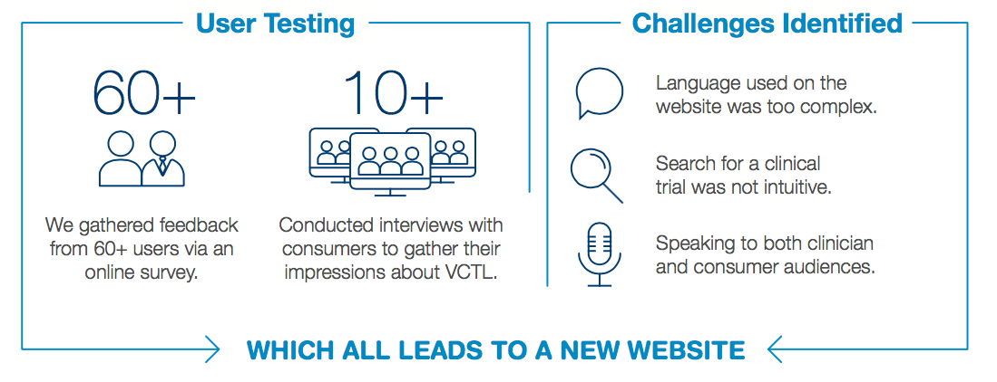
Consumer friendly information and support
Victorian Cancer Trials Link:
Notes:
As I mentioned, the data we collect with sites through the Cancer Trials Management Scheme provides a platform for us share specific information about clinical trials through the Victorian Cancer Trials Link.
Established in 2009 as a way for trial sites to share their clinical trials with others in Victoria, the Victorian Cancer Trials Link is an online portal that aims to link patients and clinicians with locally occurring clinical trials and general resources for people affected by cancer. Most trials on the VCTL are systemic therapy treatment intervention trials, but the website also lists trials of radiotherapy and surgical treatment modalities.
Whilst similar platforms exist, the Victorian Cancer Trials Link is unique because it provides local, cancer specific information and is able to match people to clinical trials based on their age, diagnosis and treatment history. It is also available to download on your phones, in app format.
In 2017, with support from a local philanthropic organisation, we undertook a review of the Victorian Cancer Trials Link, to ensure the information we provided on the platform was suitable for the growing consumer audience. We collected iterative feedback about the content, usability and design of the Victorian Cancer Trials Link and common challenges were identified and addressed.
Based on this feedback, new features of the website included a more intuitive search bar function; an advanced keyword search; simplified trial information and headings; an interactive hover glossary sourced from our colleagues in Cancer Research UK; quick access to Cancer Council Victoria’s experienced cancer nurses; and a suite of resources that provide patients with general information about cancer clinical trials, prompting patients to start a conversation about trials with their doctor.
Since we launched the new versions of the website and app, we have attracted an international and interstate audience (together accounting for nearly 50% of users), suggesting that there is demand for this type of resource outside of Victoria. We have also observed more quality engagement with the platform; and in the past 6 months just over 9000 people have initiated a search for a clinical trial using the website. While we do not collect data to suggest this increased engagement has led to increased referral into clinical trials, it could suggest more people are aware and engaging in the conversation about clinical trials than ever before. I think this is huge testament to the wonderful consumers who provided input into the redevelopment and guided our service delivery.
Increased attention surrounding the VCTL enhancement has also facilitated partnerships and ongoing support from other health service and government stakeholders in the sector; starting discussions about how the resource can be improved and utilised further.

Slide 6
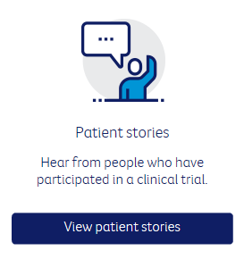
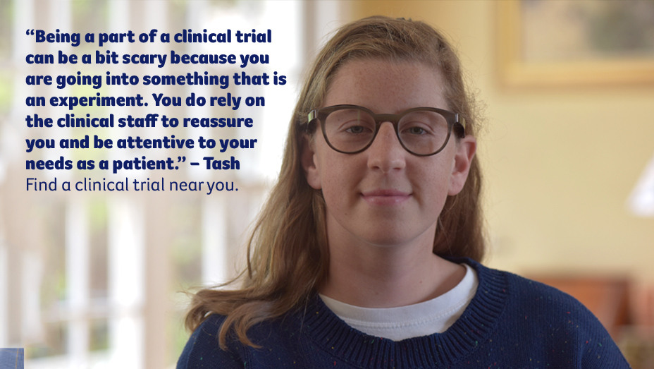
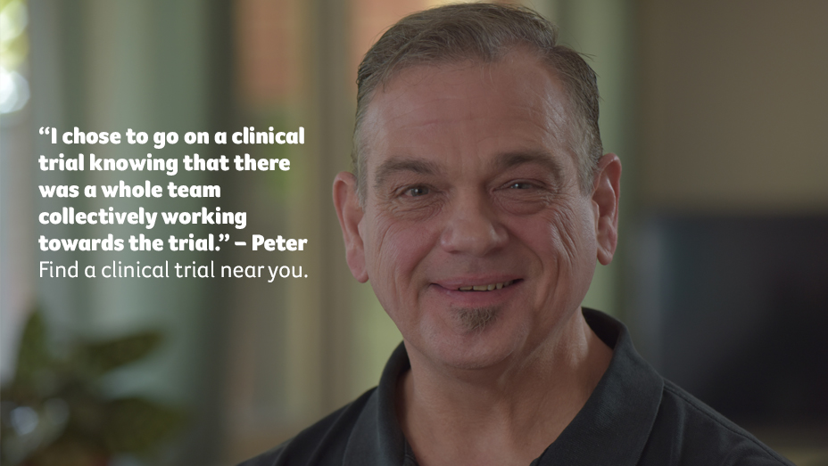
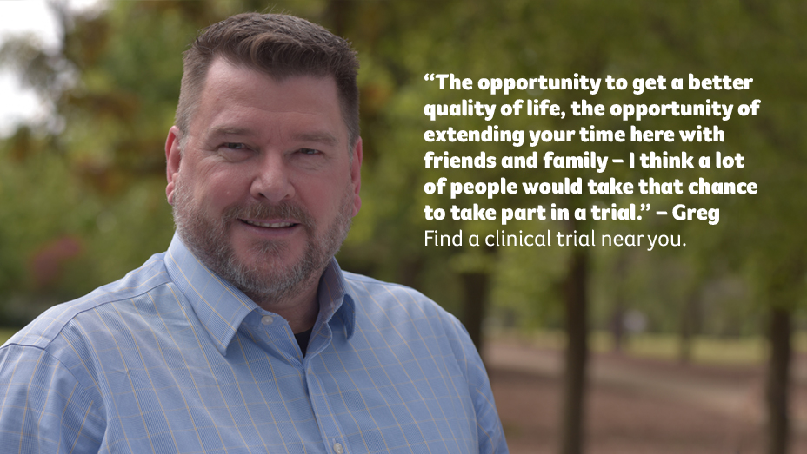
Consumer friendly information and support
Learning from consumer experiences
http://trials.cancervic.org.au/resources/stories
Notes:
As well as trial-specific information, the Victorian Cancer Trials Link also provides a platform for Cancer Council to provide more general information and support for people considering participation in clinical trials. This includes access to five videos that detail the experiences of people (Ilka, Peter, Greg and Tash) who have participated in a clinical trial. The videos were developed with consumers, as a way of normalizing clinical trial participation and an awareness for the real reasons people decide to participate in clinical trials. Each story is different, yet each story powerfully describes the significance of clinical trials from a patients point of view.

Slide 7
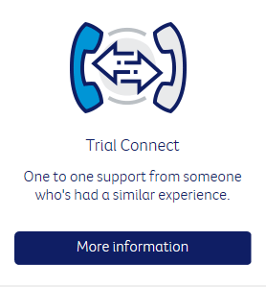
Consumer friendly information and support
Learning from consumer experiences – Trial Connect
Pilot telephone peer support program for people thinking about joining a clinical trial.
Speak to someone who has “been there before”
Unable to match on specific trials – more about the experience of participating and the decision making process
4 x volunteers recruited
5 x calls matched with a volunteers
“…Very useful. He was helpful in explaining the sorts of things a trial can entail and how he found certain questions useful to ask. It certainly helped me to understand what may be involved in a clinical trial. There is no trial suitable trial for me at the moment but it has given me more confidence to investigate in the future.”
“It was good to talk to him. In a strange way I felt good although there was not going to be a trial for me. I spoke to him for an hour. He was keen for me to talk to my Doctor and ask questions... I feel able to ask about future trials. He was a good listener.”
Notes:
In addition to the patient stories, we have also piloted a peer support program called Trial Connect. Recognising the conversation about clinical trials is often difficult, Trial Connect aims to connect people who are considering participation in a clinical trial, with someone who has “been there before”. It is a free and confidential telephone service that is based on an existing peer support program at Cancer Council, called Cancer Connect.
The program works by connecting a potential clinical trial participant with an experienced volunteer who is able to address their questions about clinical trials. While our volunteers can not provide medical advice to callers, Trial Connect does offer a platform to talk about the experience of being in a clinical trial, speak about the importance of clinical trials and dispel myths about clinical trial participation. The program is able to provide support people, regardless of location of treatment and home address.
We have received positive feedback about the program, despite only connecting five people with a trained volunteer. Uptake to the program has been slower than expected, however this is likely a consequence of our unstructured promotion of the support service, which primarily targeted trial sites rather than outpatient/inpatient units. This is something we would like to address as we continue to deliver the Trial Connect program.
Although we took a program delivery approach to providing peer support, I think there are opportunities to integrate this into everyday practice, whether this be via informal ‘connections’ on the ward or by asking patients to indicate their desire for peer support at the beginning of their treatment. Having someone to speak to about participation in trials may be the difference between eventual recruitment and adherence in the clinical trial itself, and based on the feedback we received from participants, is definitely something that is missing in current services.

Slide 8
Conclusions:
Sector engagement in the Victorian Cancer Trials Link and Cancer Trials Management Scheme means:
We are able to report complete cancer clinical trial activity in Victoria.
Greater opportunities to build capacity of the sector and increase patient access to clinical trials.
Learning from consumer experiences is essential to improve patient access to clinical trials.
Notes:
For Cancer Council Victoria, integration of the Victorian Cancer Trials Link and Cancer Trials Management Scheme, has meant we are the only body able to comprehensively report on clinical trial activity in Victoria. By leveraging existing resources and relationships with clinicians and consumers, Cancer Council are taking a multi-component approach to improving patient access to clinical trials and building capacity of the Victorian sector.
Using sector and consumer experiences to improve resources like the Victorian Cancer Trials Link and promote the importance of clinical trials in the delivery of optimal cancer care has been essential to our efforts of improving patient access to clinical trials in Victoria, especially in a country where clinical trials are not well integrated into our health care system.
While the programs I have spoken about today may not translate into the context of your work, key learnings for me that are translatable are the importance of:
Sector wide approaches to clinical trials, including patients as important resources in the delivery of optimal care.
Having a patient-outcomes focus, recognising the reasons why we do clinical trials and introduce initiatives aimed at building access and capacity of clinical trials, is to improve outcomes for our patients now and in the future.
For more information about each of the programs discussed, please feel free to contact me via christie.allan@cancervic.org.au or in person throughout the conference. Thanks!

