Slide 1
Communicating About Clinical Trials
Dr Verna Lavender
Senior Lecturer in Cancer Care Oxford Brookes University
Cancer Nurse Researcher Oxford University Hospitals NHS FT
Oxford Clinical Academic Fellow
vlavender@brookes.ac.uk @vernalavender

Slide 2
Talking about cancer trials with young people
Widespread reports that participation of young people with bone cancer (sarcoma) in clinical trials is low although open trials are available; the reasons for this aren’t well understood
We investigated factors that influence trial participation of young people (aged 15 -24) with bone cancer (Pearce et al., 2016; Lavender et al., unpublished)
In-depth interviews were conducted with 21 young people and 18 health professionals (HPs) at a teenage and young adult (TYA) cancer centre, which was also a regional sarcoma centre
A combined ‘analytical framework’ was developed from thematic analysis of all interview transcripts (Pearce et al., 2016) and additional distinct emergent themes identified from HP interviews (Lavender et al., unpublished)

Slide 3
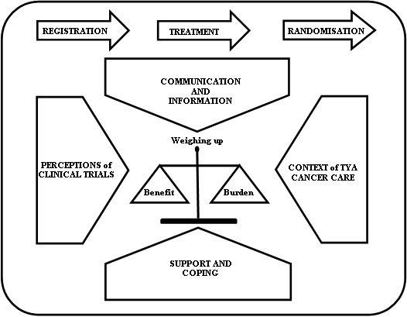
Combined analytical framework
What the TYAs and HPs said about bone cancer clinical trial participation had ‘high-level agreement’
We identified:
Critical time points where arguably more support is needed
Influencing factors on weighing up benefits (enablers) and burdens (barriers) of clinical trial participation

Slide 4
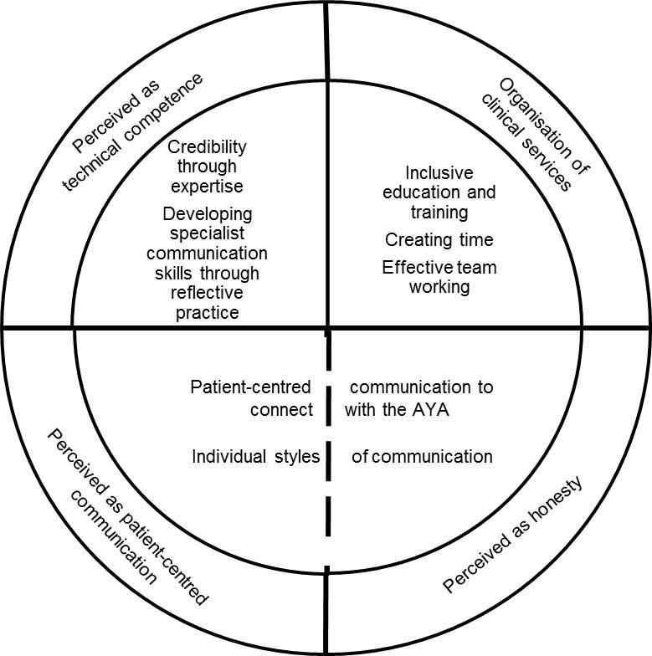
Emergent themes from health professional interviews: Patient-professional trust
Professional expertise and the development of specialist knowledge and skills
Strategies used to develop trusting relationships
We aligned our findings about how health professionals communicate about clinical trials with young people with four characteristics of patient-physician trust (Hillen et al., 2011)

Slide 5
What we learned…
The design of clinical trials should consider the acceptability of the trial
Additional care and support is needed at critical time points
Addressing influencing factors should improve participation in clinical trials
Using a family-inclusive approach and facilitating peer-support helps the decision-making of young people about trial participation
Trusting patient-professional relationships are central to communicating effectively about clinical trial participation
Strategies used by health professionals to communicate can inform training and enable the development of specialist expertise within local contexts
Effective communication increases team-work and reduces confusion across care settings
Nurses are an important part of the team for ensuring continuity in communication, information sharing and provision of care
There is scope to transfer our findings to other contexts of clinical trial recruitment: Effective communication is central to trial success

Slide 6
References
Hillen, M.A., H.C. de Haes, E.M. Smets, Cancer patients' trust in their physician-a review, Psycho-oncology, 20 (2011) 227-241.
Lavender, V., F. Gibson, A. Brownsdon, L. Fern, J. Whelan, and S. Pearce, Health professional perceptions of communicating with young people about bone cancer clinical trial participation, Supportive Care in Cancer (2018) doi: 10.1007/s00520-018-4337-4
Pearce, S., A. Brownsdon, L. Fern, F. Gibson, J. Whelan, V. Lavender, The perceptions of teenagers, young adults and professionals in the participation of bone cancer clinical trials, European Journal of Cancer Care (2016) doi. 10.1111/ecc.12476

