Slide 1
Virtual National Cancer Information Center Kevin Babb Vice President, NCIC

Slide 2
NCIC—A Virtual Contact Center
The decision to go virtual
The move to virtual
Ongoing support for a virtual NCIC
Notes:
During today’s presentation, I will review these three areas:
How we came to the decision to go to virtual operations,
Our process to move to virtual
And the ongoing support for our virtual contact center

Slide 3
Notes:
NCIC had a Work From Home program for many years. The program was a part of our Disaster Recovery plan. For example, WFH staff could continue providing help to constituents in cases of inclement weather, when staff could not make it into the center. However, in 2017 several factors led to the decision to go 100% virtual.

Slide 4
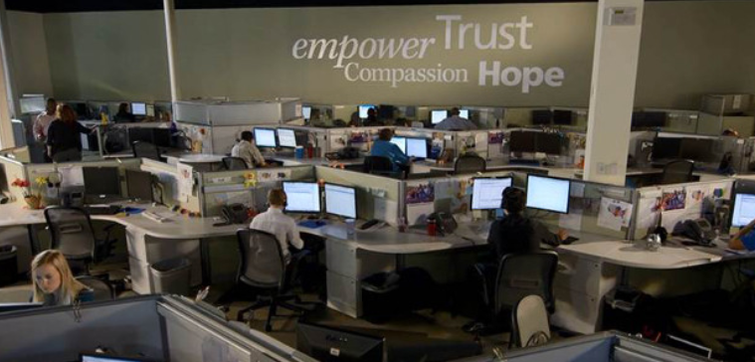
The Decision
What Happened:
Building lease
ACS Exploratory Group
History: NCIC was already supporting 100 + top performers virtually
Considerations:
Labor Force Size
Demographics
Spanish Speaking
Contact Center Skill Set
Percentage of Bachelor’s Degrees
Average Salary for Contact Center
Contact Center Saturation Rate
Real Estate Estimates
Notes:
The ACS building lease was approaching expiration in Aug 2018. An organizational exploratory committee was formed to investigate various options: renewing the lease, finding a new building/smaller building in the Austin market, finding a building/smaller building in more favorable market.
Austin is a favorable strong market for language skills but falls below the U.S. average for contact center supply and Macro costs, which indicate a higher cost of living and high median household incomes
A decrease in ACS income development/revenue generation drove the need for enterprise-wide cost savings.
The current building lease expired in August 2018; the facility did not meet current needs, which would mean relocating in Austin’s expensive real estate market.
Relocating Austin staff to a comparable city with an affordable real estate market had costs and risks, including severe attrition and knowledge loss.
The NCIC staff desire to have a greater work life balance and reduce cost of living expenses created by travel costs and time.

Slide 5
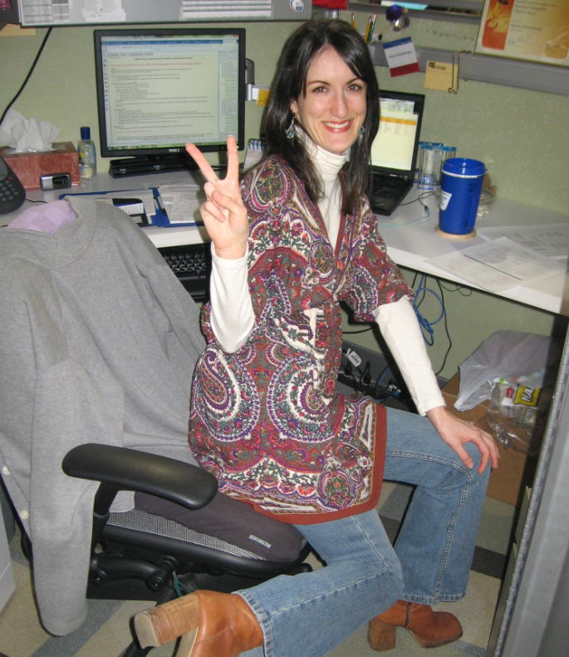
What the other cities did NOT have:
Our talented staff and strong knowledge base

Slide 7
NCIC Virtual Workgroups
Hiring Process
Learning
Talent
Managing Changes
Budget
Facilities
Communication
Tech
Staff Plan
Notes:
We first laid out the work that needed to be done and formed several teams to get that work done. The Strat team worked to lay out this structure even before we had all the pieces in place to announce to our staff.
Hiring Process—Recruiting and Onboarding
Learning—Training, New CRM Tool (Salesforce), Bridge (Follows Classroom Training, extended support for new staff)
Talent—Legal, ADA Accommodations, Privacy, Policy, Disaster Recovery, Compensation
Managing Changes---Culture, Change Management, Networking
Budget—all budgetary considerations
Facilities—all facility considerations involved in closing down the building
Communication—Communication plan for contact center staff and broader organization, updated procedures, communicating in a virtual workspace
Tech—equipment and supplies
Staff Plan—plan for moving staff home and supporting them in a virtual workspace
Additionally, ACS formed a Core Team of leaders throughout the Society to provide oversight, guidance and push through barriers that might arise.

Slide 8
Timeline
August
2017
Announcement of Virtual Move to Staff
December 2017
Staff decision on if they will WFH
January
2018
First test of Virtual Learning Content
March 2018
75 % of Staff WFH
April
2018
First 100% Virtual Training Class Begins
July
2018
Building Closes
100% of Staff WFH
March
2018
100 % use of video cameras
Notes:
Snapshot of some of our key milestones:
December 2017 Staff decision on if they will WFH—Offered a retention bonus to staff who were unable/not interested in WFH but who agreed to stay in role until the close of the building
Understanding potential staff losses and getting those staff to bridge the gap until they left was critical to providing uninterrupted service to our constituents.
January 2018--First test of Virtual Learning Content—Trainer Remote, Trainees in house
April 2018-First 100% Virtual Training Class Begins—Various components of training were done virtually prior to this. However, this class never came into the building for training or work.

Slide 9
Virtual Training
Virtual training is different! ☺
HOW?
People engage content differently
More guided self study and activities that check in on comprehension build onto presented material
Added small group to foster peer support and team culture
Training and Support
Virtual onboarding
Leader development
Increased engagement
Notes:
Moving our onboarding program to a virtual format was one of the biggest tasks
Created and tested virtual onboarding for all roles
Provided development and resources for supervisors and managers
Found opportunities to increase engagement
We had a successful WFH program for years, but had never recruited, hired or done basic new hire training virtually.

Slide 10
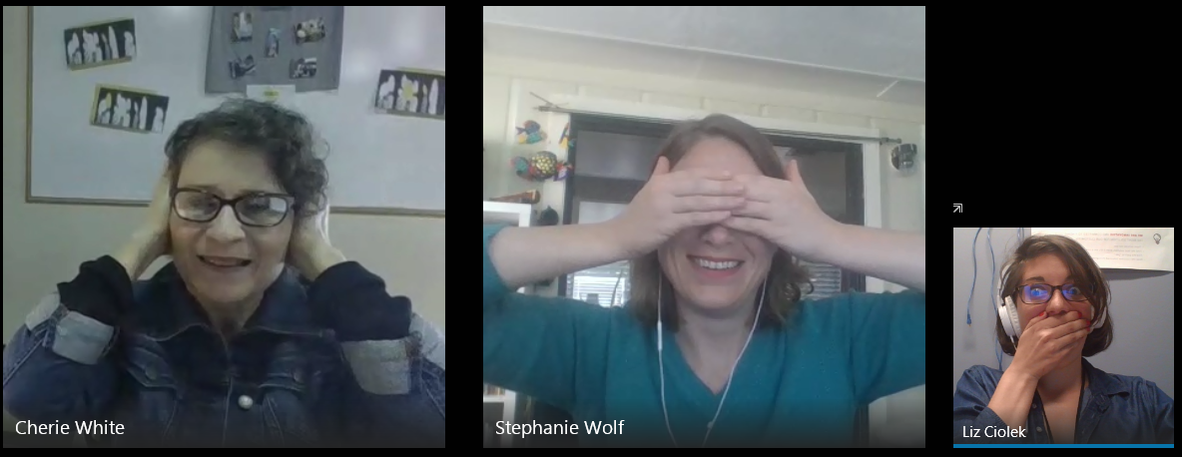
Engagement & Communications
Defining our NCIC culture and exploring how it translates in a virtual workspace
Video Cameras
Skype calls
Social Media tools
Notes:
NCIC Culture
Inclusive Culture
Pride and Passion in Helping People
Caring, Compassionate, Supportive
Teamwork/ Team Focus
Feeling well supported by peers and NCIC leadership
Video Cameras—all staff were provided a camera and asked to use in meetings, trainings, etc.
Skype – specialist teams use skype ‘chat rooms’ to connect throughout the day—ask work questions, socialize between calls, games, etc.
Social Media tools– explored various communication tools to enhance virtual engagement, piloted Workplace, but landed on developing a plan to expand the use of enterprise tool—Yammer,

Slide 11
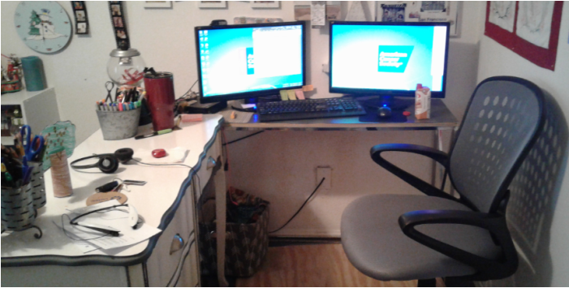
Other Considerations
Safety
Human Resources
Successful WFH Arrangements
Separate the workspace
Be accessible
Stay connected
Communicate regularly
Office equipment
Facility considerations
Notes:
Safety
Maintain a safe and accident-free workplace
Set up an ergonomically correct workstation
Self-assessment using the Home Office Safety Checklist
HR related issues like:
Compensation—pay range may shift when relocating outside of the Austin area.
Taxes--there may be changes in your tax rate if you relocate. You’re responsible for these and you should work with your tax pro with any questions.
Stipend—ACS provides a monthly internet stipend.
Successful HBW Arrangements
Separate the workspace from the home environment if at all possible.
Be accessible during core work hours. It is critical that HBWs are just as accessible to their supervisor, co-workers, and others as those who are on-site.
Stay connected. The HBW should make a point to attend staff meetings, training sessions, and social functions.
Communicate regularly with supervisors and coworkers by phone. Use webcams when possible.
Office equipment
Provided by ACS:
A desktop computer that includes CPU, monitor, keyboard, mouse, webcam, and all power cords.
A headset
**Delivery of equipment to staff in advance of training, day-1 equipment setup and equipment returns have been challenging to work through
Provided by Staff:
A home phone that has a 2.5mm headset jack
A home land line
A desk and chair
A dedicated home office space
Renter’s or Homeowner’s insurance
Internet Connection
Facility considerations
Facility team worked to close down the building area by area / some staff had to relocate during the process.
Wind down of in-house

Slide 13
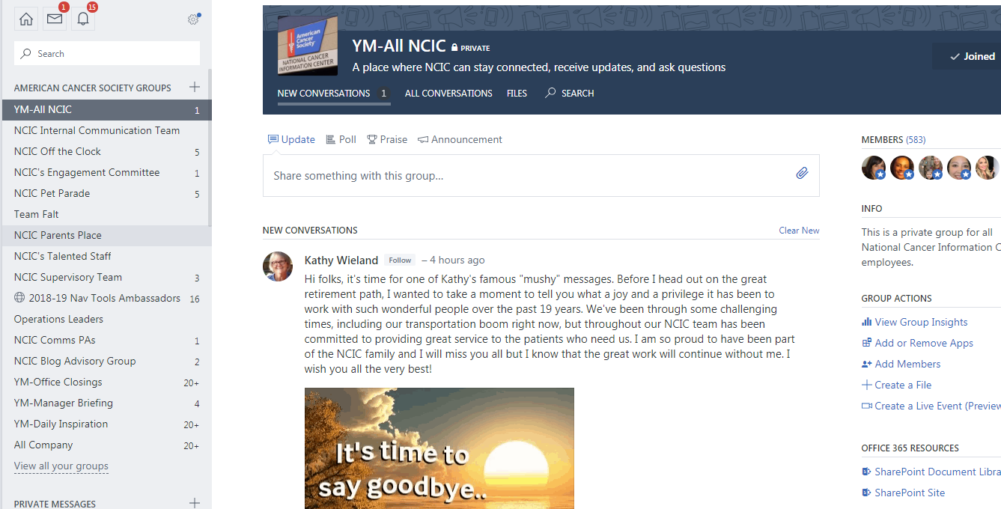
Ongoing Support
Training
Collaborating & Refining
Communication
Virtual engagement through Yammer
Notes:
Training:
Updating processes and tools to support virtual learning for learners/trainers/presenters/mentors
Refining approach based on lessons learned
Preparing for launch of new CRM tool—test of training in the virtual workspace
Communication:
Expanding and tweaking the use of Yammer to engage staff
Various groups include Team group, All NCIC Work related group, Off the Clock (virtual breakroom) Pet Parade, Parents Place and more
Staff can seek input, share stories and praise, etc
Strategic team has intentional plan of actively engaging staff on Yammer
Even though we’re adding a new tool--streamlining

Slide 14
Ongoing Support
Cultivation of Virtual NCIC Culture Includes…
Three Distinct Areas of Focus
Specialist: Take action to feel connected
Leadership: Take action to ensure staff feel supported
Center Wide: Create forums and activities for all staff to feel included and engaged
Notes:
After analyzing the survey and focus group data, as well as the role of the Community, we identified 3 distinct areas of focus to ensure a continuation of our current culture into the virtual space, as well as opportunities to improve our virtual work environment.
We want staff to feel connected, supported, engaged, and included. These goals and solutions were divided into Specialist Actions, Leadership Actions, and Center wide programs.
SPECIALIST ACTIONS:
Participation in:
Skype Group Chat
Utilize Video Cameras
Communication Tools
Continuing Education Opportunities
Keep Up with Information Tables and Refresher Blog
LEADERSHIP ACTIONS:
Intentional daily interaction with team
Participate in Yammer groups
Welcoming new team members
Explore Broadening of RP support
Center surveys
CENTERWIDE:
Creation of new “Engagement Committee”- focus will be to streamline and create new opportunities via the Yammer platform for peer engagement and support and coordinate other events like team sports, leadership happy hour or Food Truck Fridays
Explore second team meeting dedicated to team building
Promotion of enterprise resources: Red Brick, R&R
Explore Center wide employee appreciation

Slide 15
Ongoing Support
Weekly Pulse Survey
One question survey sent weekly to frontline staff
Results reported by teams / roles
Looking for trends
Weekly discussion in Yammer
Notes:
Questions for reference:
Connection to Peers
On a scale of 0-5, I feel connected to my peers
On a scale of 0-5, I am proud to be a member of my team
On a scale of 0-5, I communicate with my peers
Connection to Supervisor
On a scale of 0-5, I feel supported by my supervisor
On a scale of 0-5, I know where I can turn to get help when needed
On a scale of 0-5, I communicate effectively with my supervisor
Satisfaction with Technology
On a scale of 0-5, I am confident in troubleshooting tech issues when they come up
On a scale of 0-5, I am confident in using technology available to me in my role
On a scale of 0-5, When personal troubleshooting isn't effective, I feel confident that my support team resources (NCIC Response phone, Supervisors, Managers, IT Help desk) will resolve my issue
Overall Satisfaction Virtual NCIC Model
On a scale of 0-5, Working virtually helps me balance my work and home life
On a scale of 0-5, I would recommend working at home for NCIC to a friend
On a scale of 0-5, I am satisfied with the NCIC work from home model

Slide 16
Measuring Success
When we are successful then …
We will save donor dollars
We will pioneer how innovative change can drive more money toward mission
We will retain and enhance the current NCIC culture
We will have an increasingly inclusive virtual workplace with an enterprise mindset and geography
We will have seamless processes for staff and constituents in virtual recruitment, training, management, processes, and tools
Notes:
If NCIC makes this change, then …
Moving to a virtual environment will save the Society $900,000 the first year and $1.6 million (est.) (include this?) in subsequent years. More cost savings = more ways to attack cancer from all angles.
Staff will receive the benefits of a virtual workforce, including mobility and increased work-life balance.
We will retain our NCIC Austin based talent.
We will dramatically expand our applicant pool, by recruiting across the nation.
We are thus planning to …
Reduce the cost of a physical footprint while we preserve the experience, talent, and institutional knowledge that exists at the NCIC.
Leverage advances in technology to support a virtual workplace.
Create a state of the art virtual contact center.

