Slide 1
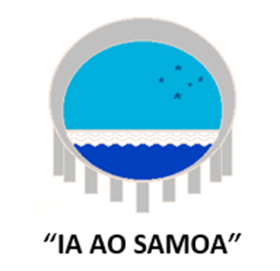
“Cancer”….a Ma’I Palagi (European Illness) – How Samoan people view cancer and how this affects their health seeking behaviour in the context of Cancer.
Dr Malama Tafuna’I
Senior Clinical Lecturer
National University of Samoa
World Cancer Congress Kuala Lumpur 2018

Slide 2
Samoa
Setting
Health services
Samoan Cultural beliefs and health seeking behaviour
Traditional healers vs Western medicine
How Samoans view “cancer”
Understanding cultural beliefs and values is key to developing culturally sensitive and appropriate services that meet needs of indigenous people – findings from research

Slide 3
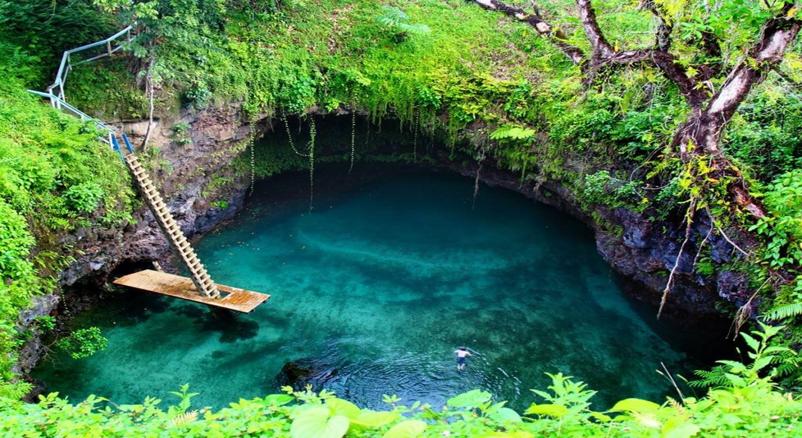
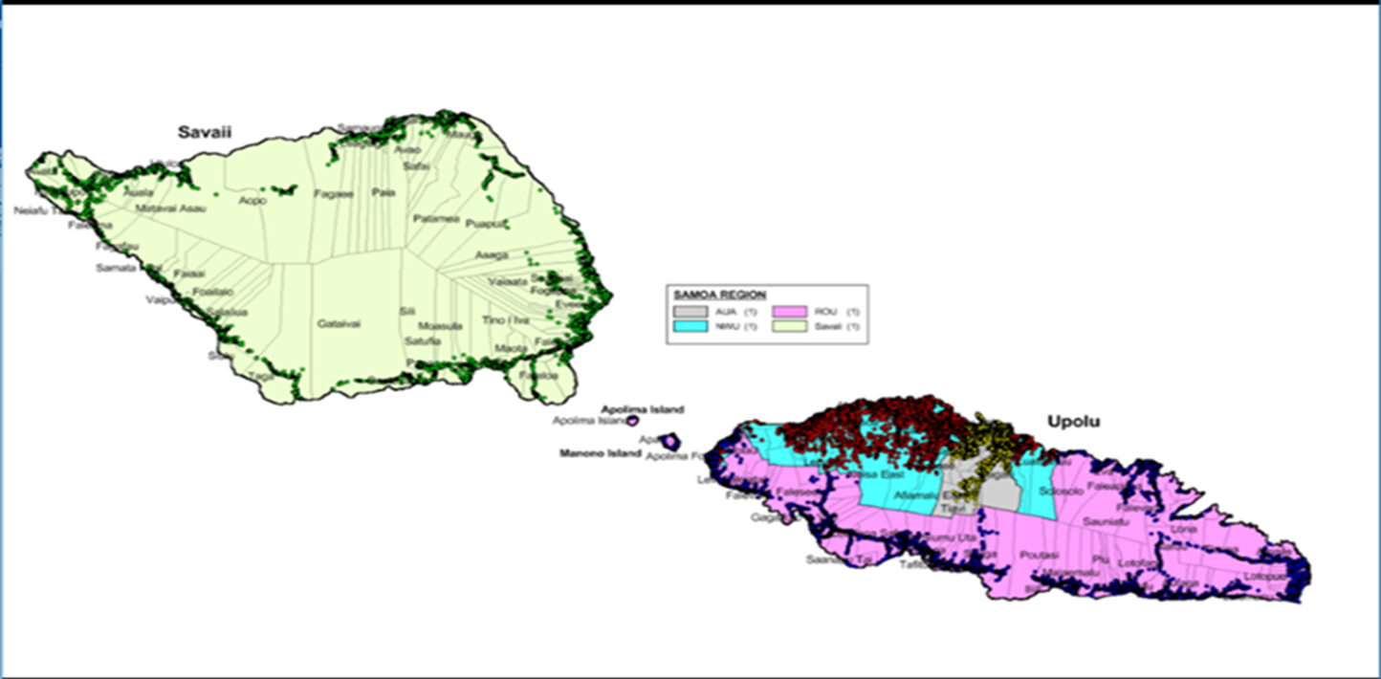
Samoa

Slide 4
Samoa’s Health System
Traditional Medicine and Healers
1800’s missionary’s
Belief that Samoan traditional medicinal beliefs went underground
Western model
Centralised
1 main hospital in Apia – 200 beds
Smaller hospital on Savaii – 20 beds
10 rural health facilities
6 Upolu
4 Savaii
German rule
First hospital 1905
New Zealand rule
1918 – Spanish flu
Western public health model
No stakeholder consultation
No attempt to understand indigenous people’s beliefs around sickness/
health
No discussion with existing traditional healers

Slide 5
Cancer in Samoa
Overwhelming burden
Anecdotally – clinicians seeing more cancer everyday and in younger people
No cancer register
No pathologist – doctor in training
People present at advanced stages of disease
Not appropriate for biopsy
Almost all have seen a traditional healer and undergone some type of traditional medicine/management
Health workers strongly suspect MANY do not present to hospital but instead present to traditional healers
Traditional healers play an important part in our peoples health care
Estimate 80% first point of call

Slide 6
Understanding of Cancer
Cancer did not exist before Europeans came to Samoa
“A new illness brought by Europeans” (Hubbell et al 2005 Am Samoa)
Meleisia 1987 “Illness often explained as a punishment by ancestral Gods for behaviour which spoilt the honour of the family”
Capstick et al 2009
Literature review of health and culture in the pacific
“Health and well being about the presence of culture” vs biomedical model
For “Samoans, it is inaccurate to conceptualise health as absence of illness and illness as absence of health – instead illness is seen as an inevitable though potent disruption to life and social systems”
“no words in Polynesian languages equivalent to the biomedical constructs of‘health’ and ‘disease’ and that Pacific ideas of health are instead linked closely to cultural identity”
Puaina et al 2007 (Samoan community in America)
“embarrassment” “Shy” “taboo” to discuss personal health issues esp sensitive issues ie genitalia, sex etc
Disrespectful to healthworker

Slide 7
Acceptability of HPV self-sampling tests amongst health workers and women from both urban and rural communities in Samoa.
Themes that came out of study:
Education
significance of cultural beliefs and values,
the value of benefits,
the concerns with literacy and health literacy,
the need for options,
the different challenges that they face and
empowerment.

Slide 8
Acceptability of HPV self-sampling tests amongst health workers and women from both urban and rural communities in Samoa.
Cancer European Illness = Ma’I Palagi
Shocked to hear cancer affected other parts of the body other than lungs and breast
Lack of awareness
Difference in explaining HPV causal effect and cervical cancer between urban and rural women
Rural women struggled to understand how female genitalia could be affected and in particular the “cervix” – could not relate to this as could not see it/ wasn’t tangible
Ambiguity of language and translation
No Samoan words for some body parts / Health concepts
Difficulties in translation
Health workers vs lay people
Embarrassment/Shy/ taboo to discuss sensitive issues ?

Slide 9
Cultural Beliefs and Values
Imposed Western health model with westernised beliefs about illness
Samoans still consult traditional healers first
Turn to western health models often in desperation
Fatalistic belief – Better not to know
Ma’I palagi needs to be cared for in the hospital / Needs western medicine
Expectation of an immediate cure
Can lead to distrust when expectations not fulfilled
Traditionally
Look after our elderly and unwell
Tausima’i

Slide 10
Cultural Beliefs and Values
Importance of understanding history and cultural beliefs and values in indigenous understanding of sickness and health to understand how these beliefs and values guide how we engage with health services and what health services
Need to engage indigenous people in these discussions to gain local cultural perspectives when designing strategies to support ones information and support health seeking behaviours.

