Slide 1
Learning Experiences of Malay Muslim Women Breast Cancer Survivors at a Cancer Resource Center
Mariana Mohd Yusoff
KanWork Cancer Society Malaysia
(T3-107)
KanWork Cancer Society Malaysia

Slide 2
OBJECTIVES :
To understand the learning experiences at a Cancer Resource Center (CRC) from the perspective of Malay Muslim women breast cancer survivors.
To explore how the context of culture shaped their experiences with the CRC.

Slide 3
METHODOLOGY
Study Design
Qualitative study
Sampling technique
Purposive sampling- to locate information-rich subjects
Criteria of Selection
Have visited and experienced with CRC in Hospital X.
Diagnosed with breast cancer
In–depth Interview
Access to the researcher
Recommended by CRC
Willing to participate and share experience

Slide 4
Location
Hospital X. Why ?:
Data Collection
In-depth interview
Probing techniques
Data Analysis
Transcribing verbatim
Constant comparative method
Oldest CRC
1st in MOH Hospital
Model for other CRC
Different setting/way to operate
Audio tape recorded
1st CRC in Malaysia

Slide 5
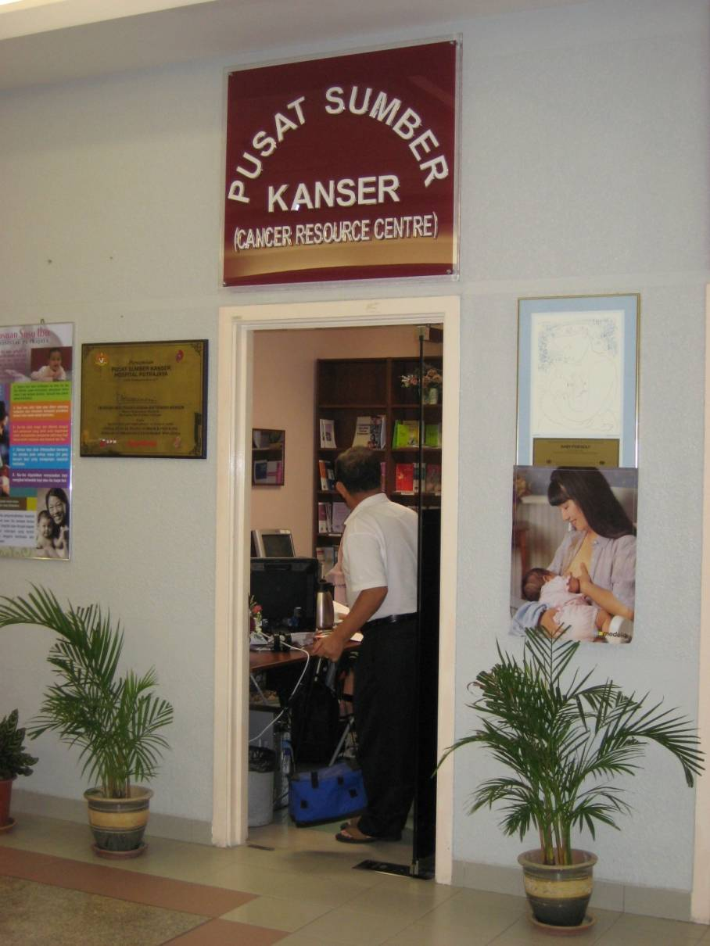
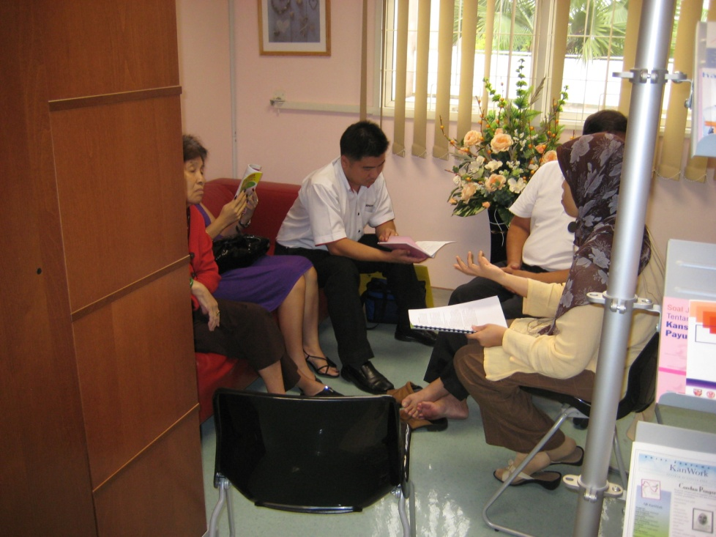
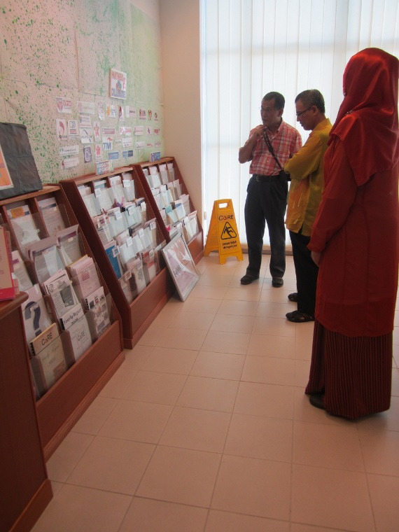
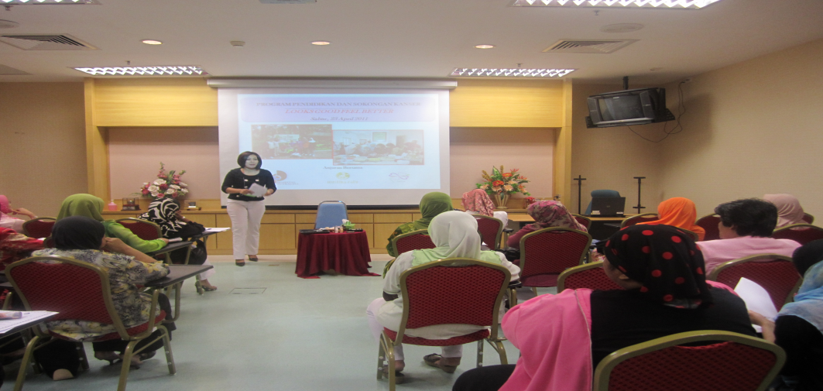
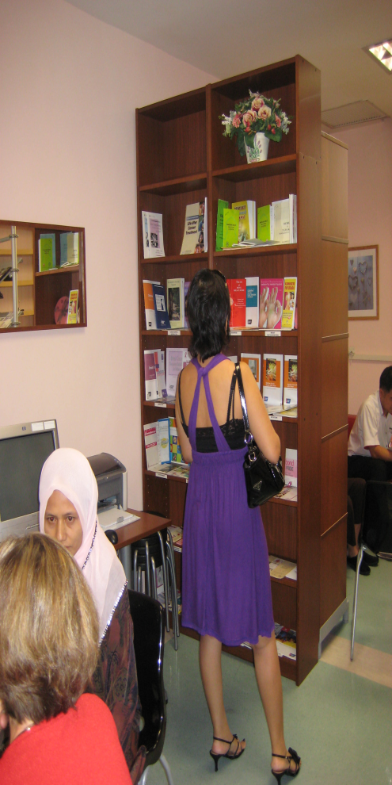
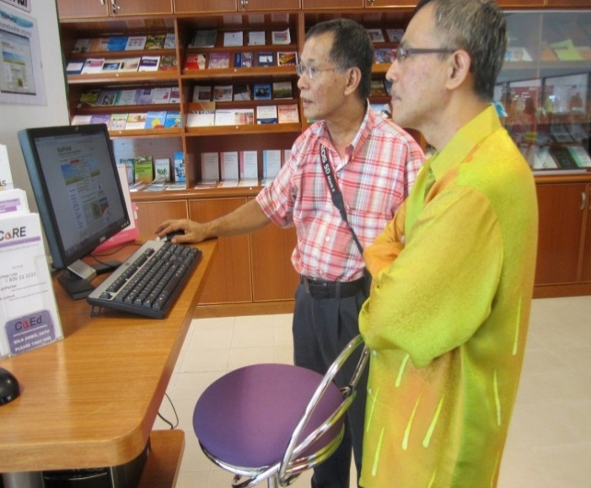
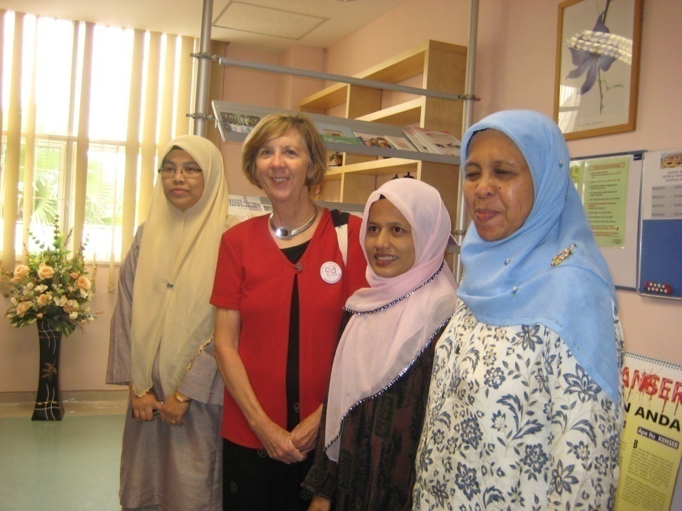
CRC
Hospital X
CaRE, UPM

Slide 6
FINDINGS/OUTCOMES
CRC played a vital role as an effective learning platform towards improving the quality of life of breast cancer survivors.

Slide 7
Learning Experiences
1. Motives to engaged in learning at CRC
Need more information on cancer (Diagnosis, treatment/diet- to reduce anxiety and fear)
To socialize
(similar/share experience)
Share experience with others:
- Nurses
- Peer survivors

Slide 8
Learning contents
Cancer disease
Cancer treatment & side effect
Food/Diet
Cancer recurrence
Coping strategies

Slide 9
Learning strategies
Utilizing Print Media : Brochures/
Books
Peers/fellow patients/
survivors
CRC education activities
CRC Nurses
Utilizing internet

Slide 10
Experience using CRC
Benefits:
Gained knowledge & information
Get Psychological support
Shared feelings, problems & experience
A place to socialize/ connect with others/friends/peers.
A second HOME :
“I feel like I am at home. Comfortable and calm. We can talk, drink and eat together”.
Challenges :
Internal : (transportation/time)
External : Eg closed/parking, queue
number

Slide 11
How does Malaysian context shaped their experience with the CRC?.
Disease Context | Learning strategies or preference context | Culture context
Cancer is a stressful and challenging disease : need to share fears/ problems/ feelings with others. | Depend on doctors and health professionals as main source of learning and not CRC. Hospital is not a platform for learning but to get treatment. Self directed, non-formal and experiential learning | Collectivist and relationship oriented. Preferred learning via talking, sharing experience & socialized with others. Learn better via their social network : nurses/ peers/ volunteers from the support group.

Slide 12
Recommendations
The establishment of new CRC needs to look & consider the culture context and the organizational factors.
The health care providers need to access patient’s profile and their information need before implement any intervention activities.
CRC need to tailor the activities not only focus on cognitive but also incorporate affective component (eg coping skills).
Support the establishment of support group eg Kanwork- The volunteers as the health promoters/agent of change.
CRC should be equip with latest, enough and appropriate cancer education materials.
CRC need to have well trained nurse and volunteers.
The administration/policy makers needs to promote the existing CRC and fully support the establishment of new CRC.

Slide 13
Thank You
Dr. Mariana Mohd Yusoff
: +6019-2349954
marianamohdyusoff@gmail.com
www.kanwork.org | Blog: kanwork.blogspot.com
+603 8940 8672 | FB: Persatuan KanWork | IG: kanwork_official

