Slide 1
How ICISG can help
ICISG pre-conference workshop

Slide 2
How ICISG can help
Members of ICISG can help with:
Needs assessments
Strategic planning
Training guidance
Resource and technology support
By providing:
Website and CIS Tool Box (www.icisg.org)
Mentoring and support via formal Liaison Service
Referral to local CIS for site visits

Slide 3
CIS Tool Box
Developed as part of a collaboration between ICISG and UICC
Based on experience and materials from CIS services around the world
Web-based tool with links to resources
Visit www.icisg.org and go to the ‘Resources’ tab

Slide 4
Who can use the Tool Box?
Any person from an organisation interested in operating a CIS
Tool Box focuses on CIS’ that provide information via telephone
Can be adapted to other types of delivery (email services, in-person/face-to-face)

Slide 5
Why use the Tool Box?
If you are just starting – use it as you plan (tools, processes)
If you already have a CIS – use it to improve and expand, based on current best-practice

Slide 6
What’s in the Tool Box ?
How to decide if you ready to start a CIS
Information on how to start and how to manage a program
Samples of materials from other CIS’
Practical lessons learned

Slide 7
Question and Answer time

Slide 8
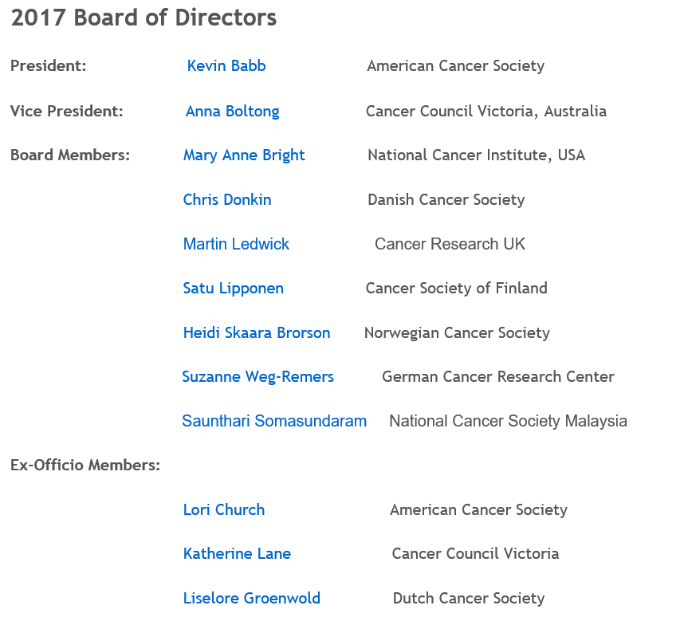
ICISG Board and contacts

Slide 9
ICISG Board and contacts
http://icisg.org/about-icisg/contact-us/

Slide 10
Thank you.

