Slide 1
CIS Helplines and example call
ICISG pre-conference workshop

Slide 2
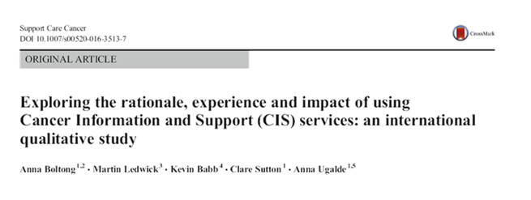
Why a CIS? The evidence behind the impact of these services

Slide 3
Results of an international study
Four themes and 25 subthemes were derived from the data:
1. Drivers for access
A sense of needing information, ‘trueness’ or support to be able to move on
2. Experience
What the service user was met with and what they came away with - the tangibles
3. Impact
What the service or the interaction with the nurse resulted in or enabled
4. Adjunct to cancer treatment services (integration)
A clear categorisation of CIS outside of, but as a useful adjunct to, health services

Slide 4
Helplines can…
ASSESS individual needs and provide tailored information
ENCOURAGE general public to take steps toward prevention and screening
ENABLE cancer patients and care givers to understand cancer and make informed decisions
SUGGEST community services and evidence-based resources to support them and their families

Slide 5
Cancer Council’s Information and Support line – 13 11 20
Nationally available service, throughout Australia
Staffed by experienced oncology health professionals
Gateway to supportive care programs and services
Complement to other care providers
Niche skill set requires robust induction and training
Shown to assist with:
Information deficits, clarification, emotions, question formulation
Reducing worry, increasing knowledge and confidence in accessing support and empowering patients to better manage their own health

Slide 6
Simulated patient and call process

Slide 8
Question and Answer time

