Slide 1
Staffing your CIS
ICISG pre-conference workshop
World Cancer Congress, Kuala Lumpur, 2018

Slide 2
Minimum requirements for staff and qualifications
Will depend on your service scope and plans:
Phone? Online? Face to Face?
Administration and operational staff?
Health Professionals?
Promotional and Marketing staff?
Technical support?
What skills do they need to come with?
Knowledge about cancer
Good communication skills
Basic computer and phone skills
Data collection?

Slide 3
Defining staff roles and scope of practice - CIS
Information and Referral? Triage of calls, emails or visits?
Hospital or community-based service?
Information provision?
Hardcopy booklets - postage
Online information – email
Counselling or emotional support?
Capacity for follow up calls or services?
Other available services such as peer support, wig services, education sessions etc?

Slide 4
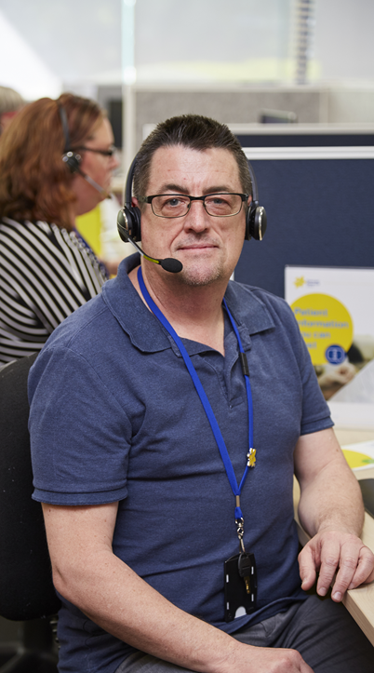
What else should you consider?
Paid staff versus use of volunteers
Levels of ability, team leaders, managers
Full-time, part-time, shift coverage
Language skills relevant to region or population
Professional development and quality assurance

Slide 5
Cancer Council Victoria example

Slide 6
Nurse recruitment and induction
Recruitment:
Minimum 5 years oncology experience
Post graduate qualifications
Need to be working clinically part-time
Consideration of workforce skills/tumour stream specialties mix
Induction:
4 weeks
Database and protocol training
Interpreter service
Double head setting with experienced nurse
Call monitoring and assessment
Experiential learning with a simulated patient caller

Slide 7
Question and Answer time

