Slide 1
Mentoring as a process in building a Cancer Information Service

Slide 2
Core elements and challenges
CIS
Content
Hiring and training
Quality of service
Process and procedures
System
Notes:
Helpline which will be eventually to a larger CIS inc. web - Stronger than Cancer
System: how to provide a complete network system with knowledge management and telephony (CRM)
QOS: training and how we assess the quality of our calls
Process and procedures: SOP – ensuring standardisation and level of service
Content: type of information – e.g. supportive, financial, medical?: what is needed vs what can be provided

Slide 3
References/mentors
NCSM
Cancer Council Victoria
Cancer Research UK
ICISG
Cancer Council Queensland
Notes:
To start with we looked at icisg website – toolkit……
We referenced what we ideally wanted with what was available
Contacted members from these various orgs – through ICISG network

Slide 4
Resources obtained
Content
Cancer Council Victoria,
Cancer Research UK
System (data collection)
ICISG
Hiring and training
Cancer Council Queensland
Cancer Research UK
Quality of the service
Cancer Research UK
Canadian Cancer Society
Process and procedures
Cancer Research UK Cancer Council Victoria
Notes:
System: toolkit for data collection. Used as a reference and expanded/ collapsed accordingly to our needs
Through direct mentorship

Slide 5
Experience
Response
Extremely quick and welcoming
Questions or requests for materials are usually met within 24 to 48 hours
Information provided
Complete and in-depth
Mentors offer detailed answers and rationale of their best practices
Going beyond
Introductions are made with external contacts who could help
Mentors are open to questions and encouraging
Requests for materials (manuals, quality assurance tools) are readily shared
The ‘right’ person to answer a particular question is often provided
Notes:
ADAPTATION……….Hybrid: used from differing mentors ------- provide information and emotional support
Having the mentors gave confidence to adapt
Easy to ask questions – advise etc

Slide 6
Challenges
Adapting extremely well-established services for an extremely new service
Hiring, induction and training
- Large team vs small team (NCSM)
- Dilemma between medical experience vs counselling skills
Quality assurance (CCQ)
- Could not be implemented fully due to the lack of trainers in Malaysia
Process and procedures
- Unsure of how ‘deep’ to go (i.e. how detailed each process should be)
Notes:
Very indepth information - very comprehensive picture of how the ideal would be
Over whelming for a new start – don’t give up faith……. Can happen with the ‘mentorship’; Olympian teaching a baby to walk
Medical experience – service provision vs communication
QOL: issues not with hardware but with the soft skills of nurses ----- lack of skill set; trainers to provide the skills
Processes: very detailed for every situation; not having the experience and knowing what sort of calls, questions etc it was difficult to determine what should be applied ------ this will come with experience

Slide 7
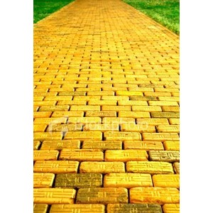
What we did
Used as many templates as possible as starting points (process of a call, email, sample interview questions).
Hired medical staff with cancer knowledge (instead of oncology background) and made use of training available in Malaysia.
Requested for process and procedures (e.g. for suicidal calls) from local helplines. Otherwise, followed resources and worked from there.
Notes:
ISCIG toolkit – templates ….. Adapted to suit our situation: especially in starting the call….. Sets the scene for nurses and patients - expectations: gives a credibility to the line and increased confidence
Befrienders, (telecoms)

Slide 8
Lessons learned

Slide 9
Lessons learned
Procedures
KISS, but be prepared
Stick to references as much as possible, but evaluate regularly (six months)
Training
Place importance on soft skills
Malaysia medical professionals are geared towards information provision
Credibility
Marketing of services
Medical service is still reluctant to use services
Uncertainty of user: confidentiality, language, sharing
Notes:
Procedures
E.g. Cancer Council Queensland induction was 13 weeks – we don’t have the resources to do the same ---- adapt
CRUK – process and procedures from CRUK
Starting point, know what to expect and prepare for, decreases the need for varied expertise from our end – decreases work load
Training – issue is ‘active listening’

Slide 10
Next steps/future wish list
Sharing of best practices with a similar service (a hybrid of information and emotional support)
A detailed evaluation of the service as well as its operations
Promoting the services (how to increase the number of enquirers)

Slide 11
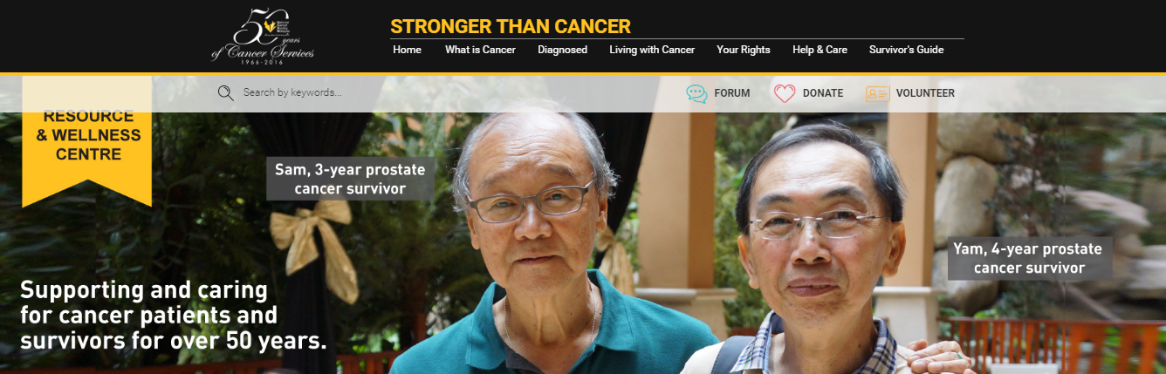
The next steps: Digital footprint
ABC microsite
Mobile app

Slide 12
THANK YOU

Slide 13
Thank you

