Slide 1
Different Voices Different Channels Delivering Information for patients through multiple channels
Introducing Online Chat With a Nurse
109M-T3
Track 3
Disclosure of interest: Non

Slide 2
Introduction
Cancer Research UK has a well used patient information offering
Cancer Chat, our online forum, gets 500 new members signing up per month
Our “About Cancer” web pages which in the first 9 months of 2016 received 28,592,185 visits
Our helpline service responds to between 12,000 and 13,000 enquiries per year

Slide 3
Our helpline service
Compliments our web information and online forum
Enquiries are answered by specialist nurses
Is anonymous
Confidential
Multichannel
12,000 – 13,000 enquiries per year
65% phone, 30% email, 5% “Ask a Nurse on our forum”
3

Slide 4
Why online chat?
To help people who cannot or prefer not to use the phone
Hearing difficulties
Can’t be overheard
Too emotional to talk
Too embarrassed to talk
But, we needed to understand more about how people would use it and how to position it

Slide 5
process
Looked at what other organisations were doing (Prostate Cancer UK, Alzheimer's UK, ACS)
Unclear if other organisation’s audiences were quite the same as ours and if their experience of chat would be the same
Wanted to do a cheap pilot/proof of concept to discover more about how it would be used on our site

Slide 6
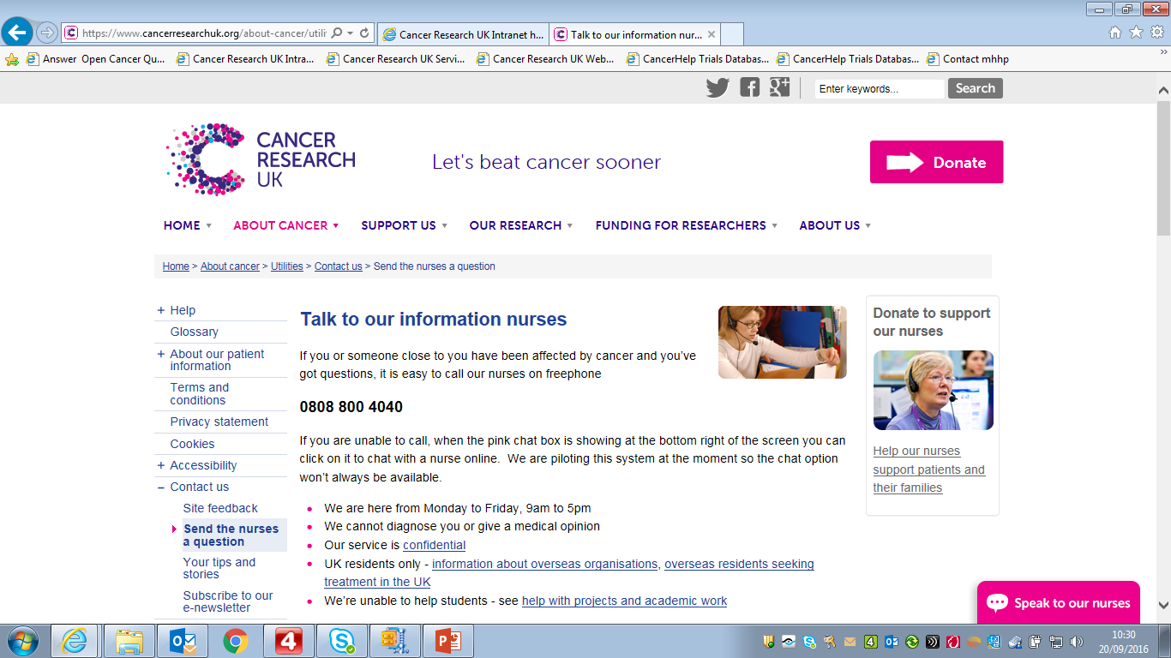
process
6

Slide 7
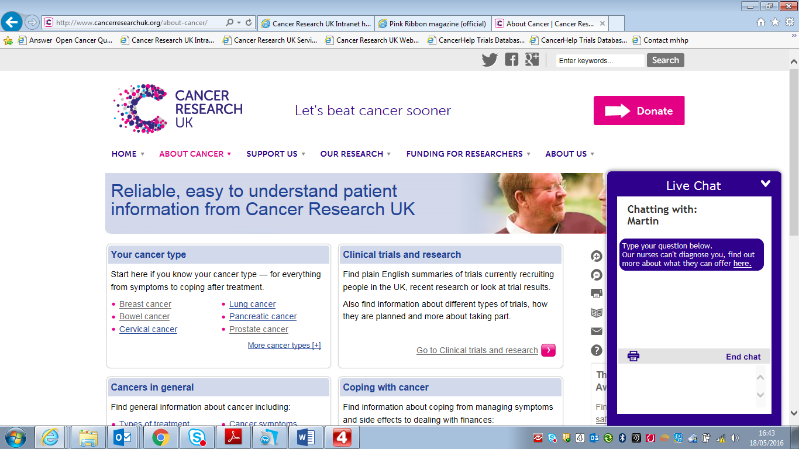
process
7

Slide 8
What we found
On every page with the chat opening instantly when clicked on, too many “silent” callers and a high proportion of people with health anxiety or warning signs that were unlikely to be cancer
Out of a sample of 80 chats 70% were “silent”, 36% non UK, and only 25% considered a useful use of the nurses time
We introduced an additional pop-up before the chat opened to try and address this
8

Slide 9
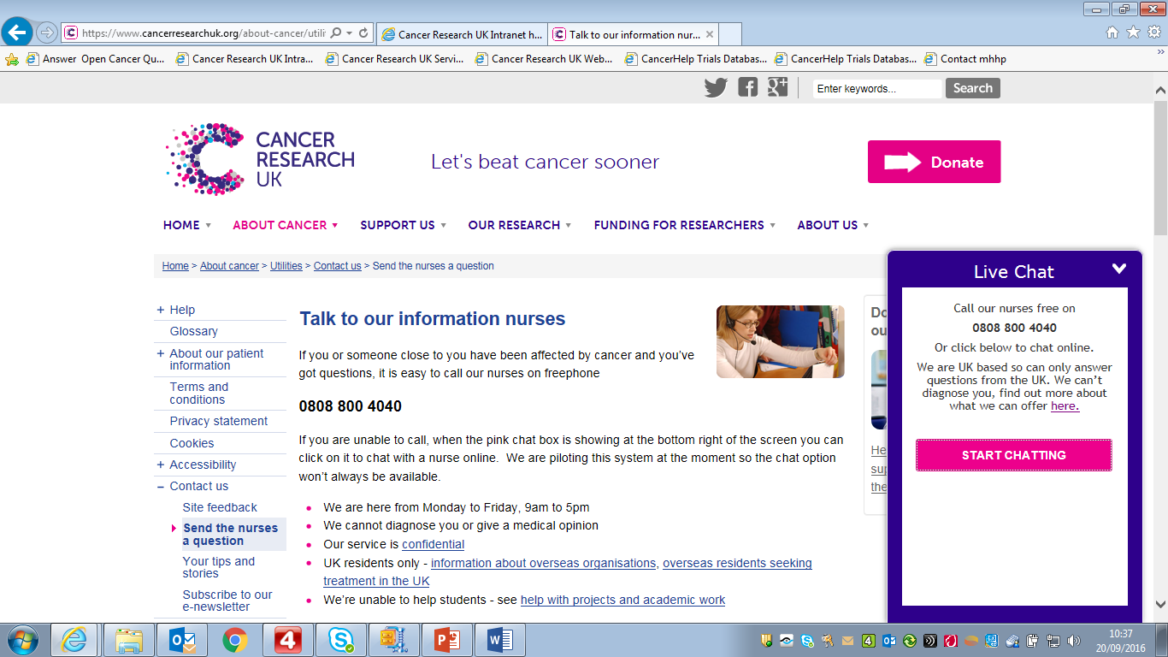
process
9

Slide 10
What we found
This reduced the number of silent enquiries but we still had a high proportion of people contacting us with warning signs that were unlikely to be cancer
Out of three samples on different dates we found that “silent” enquiries dropped to between 22% and 28% and the proportion of useful enquiries rose to between 31% and 55%
10

Slide 11
What we did next
We next put the chat box on the “contact us” page only
Demand when placed here significantly reduced but enquiries were much more appropriate
But our concern was that not enough people were now seeing the option to chat online
11

Slide 12
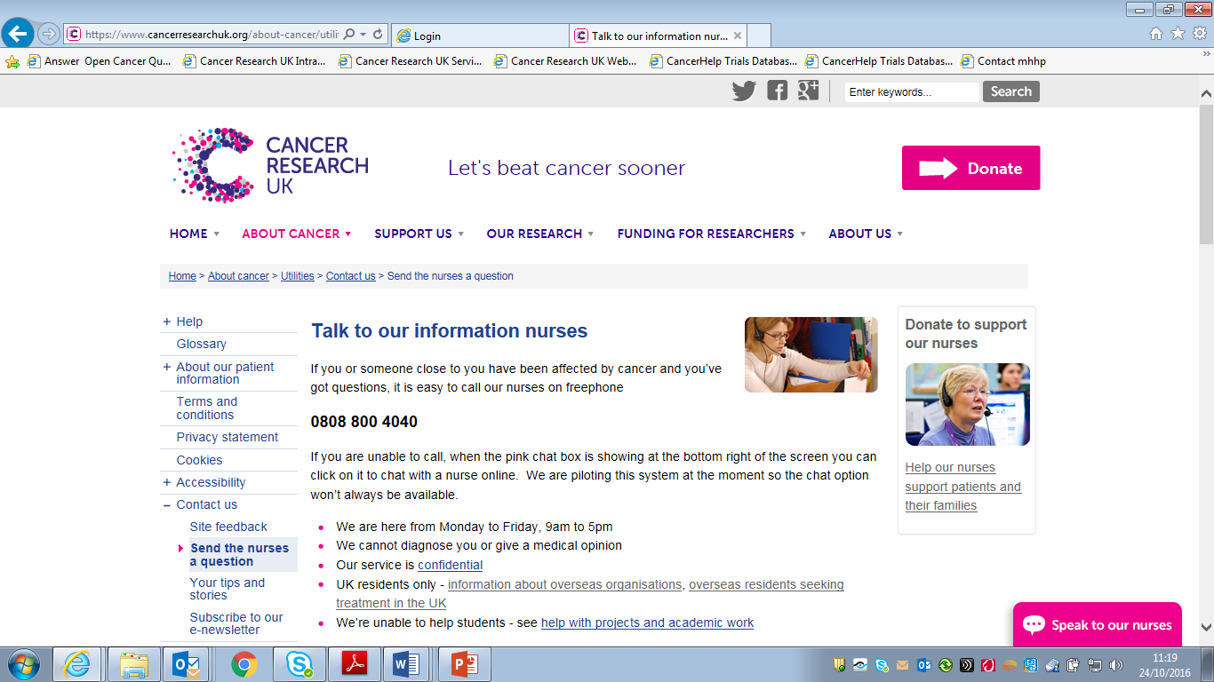
What we did next
12

Slide 13
Next iteration
The next steps are to have the chat offer only appear on the site after people have lingered on a page for some time
Our hypothesis is, that if they have remained in a page for a while they have had a chance to read it but if they have not navigated away may still have questions they need answering
We are trying this at the moment with this part of the pilot due to finish at the end of the month
13

Slide 14
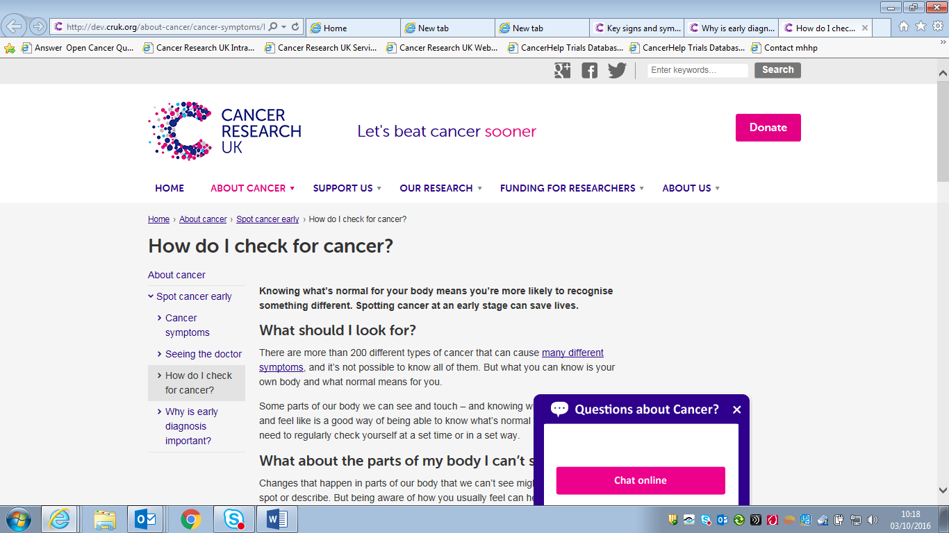
Next iteration
14

Slide 15
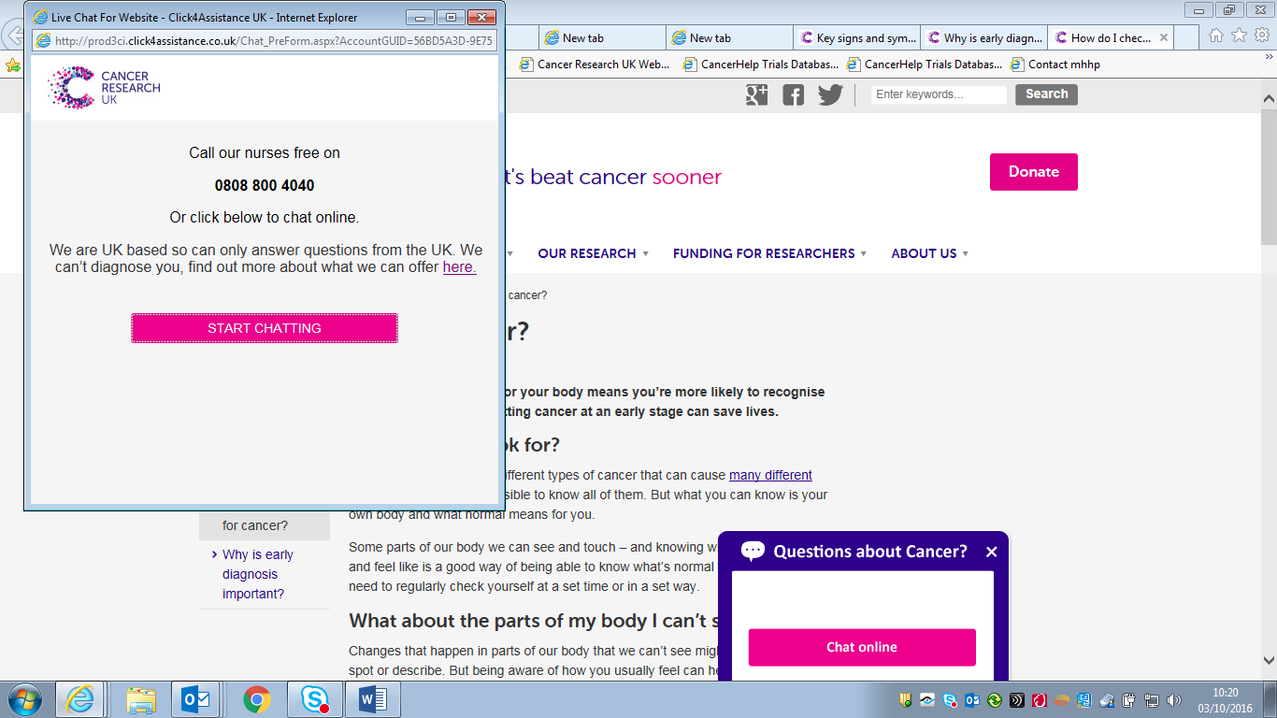
Next iteration
15

Slide 16
Thank you
Martin Ledwick RN. MSc.

