Slide 1
Using Webinars to empower and support people affected by Cancer

Slide 2

Notes:
Australia is 7,600,000 square km. We have a population just over 24 million people.
We have an uneven population distribution with almost two-thirds (64%) of the population living in capital cities.
Population density ranges from less than one person per square kilometre in remote areas to more than 1,000 people per square km in some city suburbs.
Currently there are approximately 126,800 people diagnosed with cancer in Australia per year with a 67% survival rate.

Slide 3
What is a Webinar?
A live online 60 min presentation delivered via the internet
Available on tablet, phone or computer
Facilitator and panellists with professional and personal expertise
Online participant interaction with a chat box during or after the presentation
Webinars are all recorded and available to view at a later date and archived on Cancer Councils website
Webinars are delivered in different formats; guest presenters (panel) with PPT presentations on the screen for participants to view or PPT with presenters voice only and not visual on screen
Notes:
Delivering reliable information and support for people affected by cancer can be a challenge in a spread out and often remote demographic.
Over the last couple of years Cancer Council has been trialling and delivering webinars successfully for this cohort and their health professionals
There are some key points on this slide for those of you who are not familiar with this digital technology however I think one of the key advantages is that webinars can be delivered live and recorded so access at any time after the presentation is possible from anywhere in the world with an internet connection

Slide 4
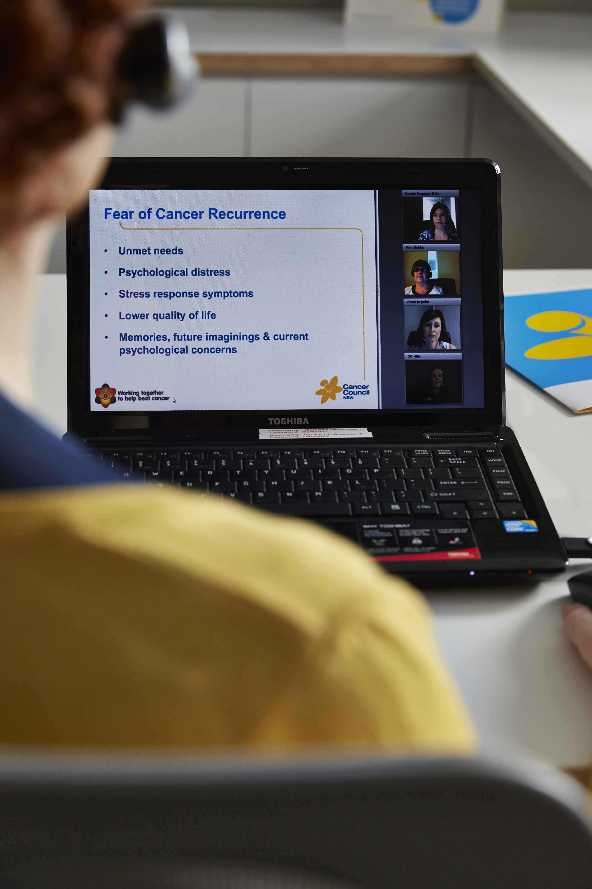

Notes:
This is a screen shot of one of the webinar formats that are delivered. As noted on the previous slide some formats have the presenters on screen and some don’t.
All have shown effectiveness

Slide 5
What works?
Convenient access to information and support, regardless of location and time
Referral pathway for other support services
A panel mix of health professionals, subject matter experts and people affected by cancer
Free access to anyone national or international and cost effective for program delivery
Good for people with low literacy as they can watch and listen
Effective reach and unlimited amount of topics available to be delivered
Provides strategies that can be implemented in everyday life wherever the participant lives
Strong peer support online
Access to key oncology health professionals that many don’t have the advantage of
Notes:
These are just some of the key advantages of delivering interactive online webinars.
As you can imagine the range of topics for all cancers and all people are endless and utilising this technology means that the most up to date information can be shared for discussion with relative ease.

Slide 6
Some key stats
25 Webinars held – Cost approx. $11.50 per participant
Total Registrations – N=6,960
Live views N=1,728 (25%)
Recorded views N=3,497 (50%)
Female 80%, Male 19%
Health Professional 37%
Major cities 68%
Regional and remote 30%
International 2%
in major cities 68%
Participant in regional and r
Notes:
Bringing together the different formats that webinars can be delivered over the last 2 years these key stats show the top level overview of our audience.
You can see that 37% of health professionals are engaging in these sessions which is up from about 25% at the beginning of 2016
We are also seeing more interest in the sessions from other countries which shows a very effective way for worldwide sharing of information and support, learning from others and enabling lesser developed countries to utilise sessions with this cost effective approach

Slide 7
How did we do?
19% asked a question on registration
57% completed exit survey
95% content was relevant to their interests and needs
90% increased knowledge
89% provided strategies
84% confident to apply strategies
90% engaged with information
92% felt it was easy to access
97% would attend another webinar
95% would refer others to webinars
Notes:
So how are we going with the exit surveys and evaluation.
Certainly what stands out is that 57% of people completed an exit survey which is an increase from about 45% at the beginning of 2016.
Another note of interest is that sessions show that they are being designed, developed and described accurately given 95% of people consider the content was relevant to their interests and needs with 90% increasing their knowledge and 97% saying that would attend another webinar

Slide 8
Comments within exit survey
“So much information in such a short time and in my own lounge room”
“Appreciated perspectives of different professionals that presented, rather than one type of perspective (just medical, legal or allied health)”
“Makes me feel like I'm not alone with the issues I'm experiencing post treatment”
“So good not to travel, and was so informative”
“Thoroughly enjoyed this webinar...I feel motivated to start exercising which has been my Achilles heel”
“Considering I am in England, the reception was fantastic. Not one hiccup or programme loss , even for a second”
Notes:
Just a few comments of so many that have been received.
The first really highlights the convenience of this method of support. The second was a comment made on an “advanced care planning for health professionals” session which highlights the importance of education for this sector.
Then we have the importance of reducing the feeling of isolation that many people experience “ Makes me feel like I'm not alone with the issues I'm experiencing post treatment”
Reach is demonstrated from the next comment from someone who is challenged with the cognitive effects of brain cancer…...”so good not to travel and was so informative”
Then we see someone who has not only learnt something but is inspired to make some healthy behaviour changes …...”I feel motivated to start exercising which has been my Achilles Heel”
….....and finally sessions such as these can be watched by anyone in the world who has an internet connection

Slide 9
Conclusions
Using online digital platforms such as Webinars are an effective, acceptable, cost effective and sustainable mode of delivering reliable information and support to people affected by cancer and health professionals
The format and information presented is meeting the needs of the participants especially where delivering face to face programs is not practical or possible
Notes:
Using online digital platforms such as Webinars are an effective, acceptable, cost effective and sustainable mode of delivering reliable information and support to people affected by cancer and health professionals.

Slide 10
Where to next?
Diverse population in Australia
Chinese - one of the largest migrant group in Australia
Aim - to improve the dissemination of information and support to Chinese people living with cancer and their families and to develop linkages with the Chinese community to improve access to coordinated and quality cancer support
Objective - Develop and deliver in language (Mandarin and Cantonese) webinar information sessions, identify and compile existing supportive care services and resources available to the Chinese community
Notes:
So where to next?
In 2015 Cancer Council was awarded a Cancer Australia Supporting People with Cancer grant and the aims and objectives are on this slide.
Australia has one of the most culturally diverse populations in the world, with 28% of the population (6.6 million people) born overseas.
Chinese (6%) make up one of the largest migrant group in Australia. Collectively, Cantonese and Mandarin are the most commonly spoken languages other than English in Australia (over 600,000 speakers).
Population-based Australian studies have shown that people from CALD backgrounds have poorer cancer outcomes compared to the native-born, English-speaking majority group. The disparities observed include lower screening rates, lower survival rates, poorer quality of life, and higher rates of anxiety, depression and distress.

Slide 11
Where we are currently
Webinars to be delivered early 2017
Three themes; Trust, Wellness, Rights
One on one peer support volunteers will be trained to work in language
Resources supporting the webinars will be available
Notes:
Findings from focus groups regarding their unmet information and support needs fell in to three themes, namely trust, wellness and rights.
Trust includes the communication barriers with health professionals, difficulties understanding and navigating the health system, comparisons among patients regarding the care they received and online information seeking (e.g., cancer information overload)
Wellness includes cultural differences that produce conflict between health professionals’ and patients’ views about Chinese medicine use and diet, as well as the need for psychological, community and spiritual support to improve wellness.
Rights encompasses the lack of awareness of financial and legal assistance as well as advance care planning practices among the Chinese community, in addition other factors such as multiple morbidities, being single, uninsured and having young families that increased vulnerability in the Chinese community members affected by cancer.
Participants narrative accounts highlighted that language, cultural and health literacy barriers compounded on the unmet needs of the Chinese community affected by cancer

Slide 12
Challenges
Cost of translation
Navigating the differing ideas people from the Chinese community have with regards to providing feedback about the cultural appropriateness of the translated materials
Myths about cancer are common(cancer is contagious), leading to difficulty identifying cancer survivors to share their personal stories about their cancer journey on the webinar
Notes:
Certainly the cost of translation has been a challenge along with navigating the differing ideas people from the Chinese community have, with regards to providing feedback about the cultural appropriateness of the translated materials. And then there are the myths about cancer and there are many with cancer being contagious one of the most common

Slide 13
Looking ahead
Build on current research project to deliver online and interactive webinars in other languages for the CALD community
Webinars can be supported with in language information resources in addition to trained cancer survivors to assist with in language peer support
Notes:
There is a tremendous opportunity to build on this current research to support other non English speaking communities. We look forward to sharing the findings from this research when the work is completed in 2018.

Slide 14
Thank you
Annie Miller – Cancer Council NSW
anniem@nswcc.org.au
http://www.cancercouncil.com.au/get-support/webinars/
 +61 2 9334 1465
Notes:
Thank you for taking the time to listen today and I am happy to answer any questions you may have

