Slide 1
Dr. Dave and his amazing radiotherapy machine
Megan Chiswell
Cancer Council Victoria, Melbourne, Australia
Notes:
This presentation is from part of a project, to support paediatric patients undergoing radiotherapy.

Slide 2
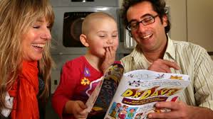
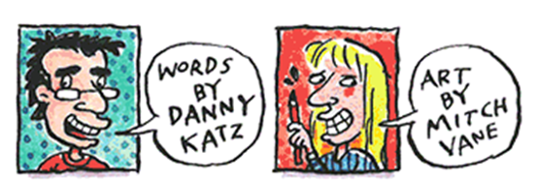
Dr Dave and His Amazing Radiotherapy Machine
Notes:
This work builds on the great work of Peter MacCallum Cancer Centre in supporting paediatric radiotherapy patients.
In 2009, the PeterMac teamteam worked with writer Danny Katz and his wife Mitch Vane who is an artist to develop a supportive care comic ‘Doctor Dave and his amazing radiotherapy machine.’
Dr Dave forms part of a suite of supportive care resources and approaches for patients at Peter Mac, and has had ongoing excellent feedback from both patients and parents.
In designing this project, the project team wished to expand the reach and accessibility of Dr Dave, so went about bring Dr Dave into Web 2.0.
Web 2.0 is the term used to describe the current state of online technology as id compares to the earlier days of the web.
Web 2.0 is characterised by greater user interactivity – this was the part that was appealing – having children interact with Dr Dave.

Slide 3
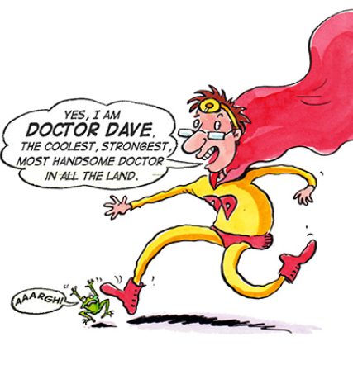
Resource design
Digital resource
Interactive – child controls interaction
Simple animation
Voices and sound
Maintain the fun of Dr Dave
Notes:
When considering

Slide 4
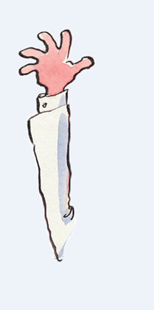
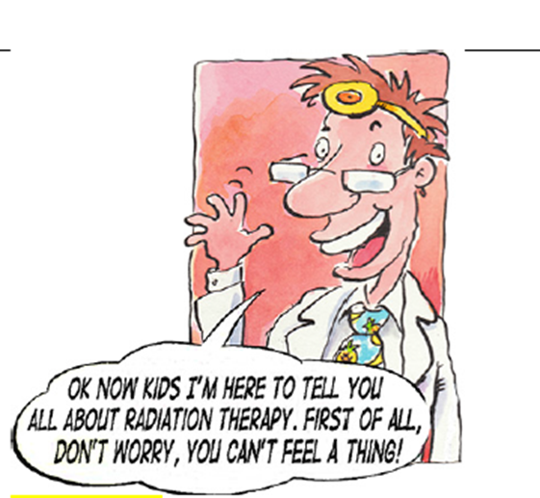
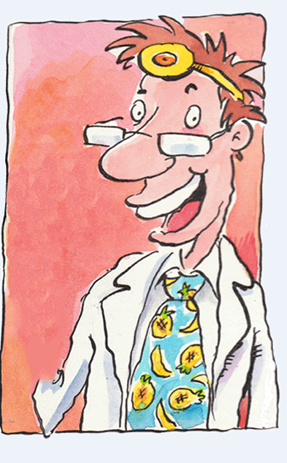
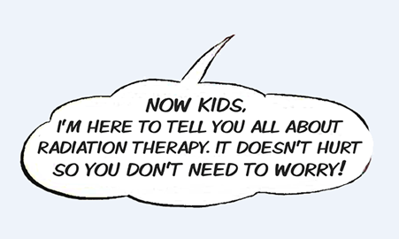
Production
Digitise
Digitise comic artwork
Identify frames for animated
Design
Define two discrete adventures
Layer artwork
Notes:
Production
The first step to production was to digitise the artwork.
Some original electronic files were located, but some pages of the comic needed to be redigitised from the hard copy comic.
Due to the cost of producing a complex animation, it was decided that simple animation of a few key elements (such as a waving hand, or blinking eyes) would be done for selected frames. These frames were identified after the artwork was digitised.
Design
In order to animate the artwork, the flat artwork needed to be layered. Layers in an image are the stackable elements that make up the image. In this first image you can see Dr Dave waving, with a speech bubble covering his body.
In determining what to animate in this frame, it was decided that Dr Dave could wave, and his words could float into the frame as he began to talk. For this to occur, each element of the artwork needed to be cut out, and where there was art missing from the layers below, it needed to be replaced. These images illustrate the layered elements of the frame. As you can imagine, this was a time consuming process. You may also note that there is a slight change to the text in the layered textbox, this came about from our stakeholder review which I will speak about shortly.

Slide 5
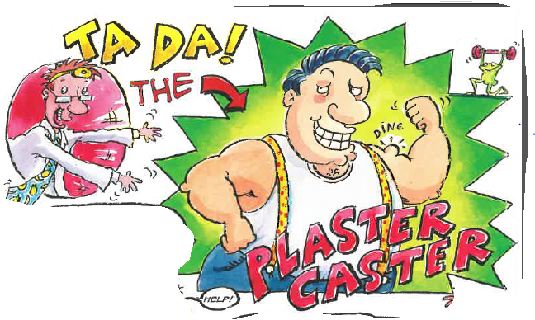
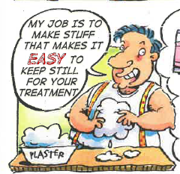
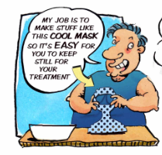
Production
Digitise
Digitise comic artwork
Identify frames for animated
Design
Define two discrete adventures
Layer artwork
Script
New artwork desined
Script and soud
Notes:
Scripts
Were developed from the original comic book. Not all of the images and text boxes were included. What to include and not include considered aspects of cost, overall look at feel of the comic and balance. Some of the elements that were not included in the comic were those that added humour to the comic. Balancing the humour and content was challenging, however the use of sound effects and funny voices in the audio clip gave an additional option to balance out what was lost.
New artwork
New artwork or modified wording was required for several frames due to changes in clinical practice, or in response to feedback from the stakeholders. One of the best examples to demonstrate this is the change in clinical practice relating to immobilisiation. When the comic book was originally designed, it featured the Plaster Caster who spoke at length in the comic about his love of plaster, and his plaster casting abilities. Clinical practice has changed, and thermoplastic immobilisation masks are standard for immobilisation. Enter the Master Caster, with his efficast mold, and a series of images of a child wearing an efficast mask.

Slide 6
Production
Digitise
Digitise comic artwork
Identify frames for animated
Design
Define two discrete adventures
Script
Layer artwork
Review
Storyboard reviewed and refined
New artwork designed
Script and sound
Notes:
Review
Internal and external stakeholders reviewed storyboard (script and illustrations) – sample of feedback e.g. “Is one of the cartoon figures able to be from another cultural background? – we couldn’t make this change.
Another suggestion was changing Dr. Dave’s line from “Don’t worry, you can’t feel a thing”. To “It doesn’t hurt, so you don’t need to worry.”
This was done. On the issue of hair loss (Adventure 2) Dr. Dave says “Lots of rock stars and footballers are bald” but that may not resonate with a girl. It was suggested that a wig be included in things you could wear. From this we asked our instructional designer to develop an image of Dr. Dave wearing a purple wig. (click to reveal Dr. Dave in wig on top right of page)

Slide 7
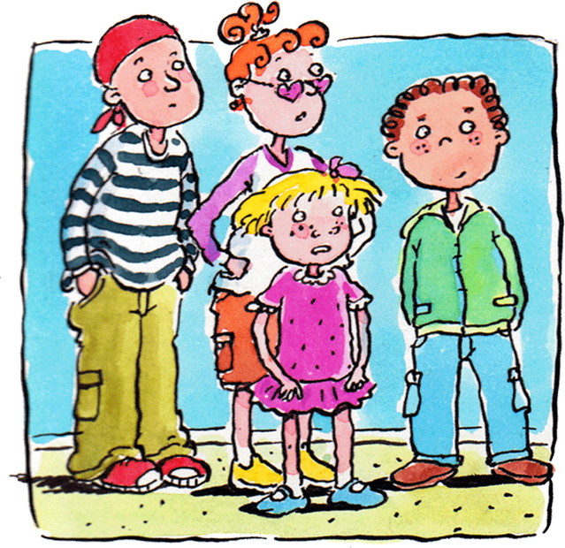
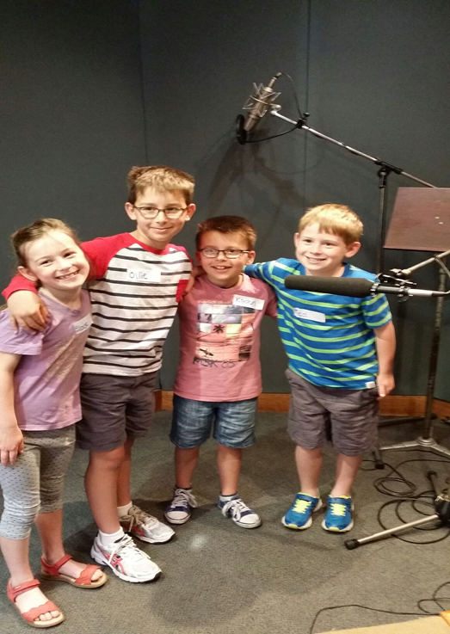
Production
Record
Production of sound track, voiceover and sound effects

Slide 8
www.petermac.org search Dr Dave
Unfortunately, the videos are too large to include with this presentation. To view them, please visit www.petermac.org and search Dr Dave or click here

