Slide 1
The Role of Social Media in Cancer Information Provision
PRESENTATION OBJECTIVES
Characteristics and some statistics on Social Media
Challenges in cancer information today
The cancer information paradox
The current status at The Danish Cancer Society
Notes:
Slide # 1 –
Thank you for allowing me the opportunity to speak to you about the role of social media in cancer information provision.
First of all I think it is important to say that there are no simple answers as to what the role of social media is.. or should be for that matter, since we are in a field where everything changes rapidly as new technological solutions are developed and the needs for cancer information change. My session is mostly based on how we use social media at the Danish Cancer Society today.
Since I am the first speaker on the subject, I will focus on the more general aspects, while the following speakers will go into detail on their specific experiences with the use of social media.
I will go through
• Characteristics of the Social Media
• Some statistics
• Challenges in cancer information today
• The cancer information paradox
• The current status at The Danish Cancer Society
• Concluding remarks

Slide 2
Social media
“.. are media for social interaction, using highly accessible and scalable communication techniques. The term refers to the use of Web-based and mobile technologies to turn communication into interactive dialogue.”
(Wikipedia / ICISG.org)
CHARACTERISTICS
one-to-one, one-to-many and many-to-many
device indifferent
enhanced speed and breadth of information
different levels of engagement by participants
Notes:
Slide # 2 – DEFINITION AND CHARACTERISTICS
Social media is described by Wikipedia as
“Social media are media for social interaction, using highly accessible and scalable communication techniques. The term refers to the use of Web-based and mobile technologies to turn communication into interactive dialogue.”
Social media have the following characteristics among others:
They allow one-to-one, one-to-many and many-to-many communications
They are device indifferent. You can use computers, laptops, tablets and mobile/ smartphones
They facilitate enhanced speed and breadth of information dissemination
They involve different levels of engagement by participants who can create, comment or lurk on social media networks

Slide 3
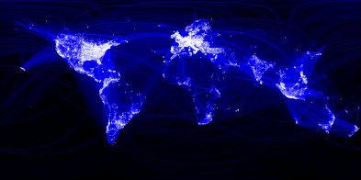
Social media can bring public health information to many more people, more quickly and directly than at any time in history Bulletin of The World Health Organization
Over 1 Billion Users Of Social Media Worldwide, Most On Mobile
Report from International Telecommunications Union
More than 40% of consumers say that information found via social media affects the way they deal with their health
90% of respondents from 18 to 24 years of age said they would trust medical information shared by others on their social media networks
30% of adults are likely to share information about their health on social media sites with other patients
Internet article on Referral MD, written by Brian Honigman
Notes:
Slide # 3 – GREAT POTENTIAL IN REGARD TO CANCER INFORMATION
Today more than 1 Billion people use social media, so for obvious reasons there is a lot of potential in providing health information and communication through the social media. The following data I found on the Internet and I believe it only covers the USA but it probably won’t be that much different in other countries around the world.
More than 40% of consumers say that information found via social media affects the way they deal with their health
90% of respondents from 18 to 24 years of age said they would trust medical information shared by others on their social media networks
30% of adults are likely to share information about their health on social media sites with other patients
Internet article on Referral MD, written by Brian Honigman

Slide 4
Basic challenges in cancer information today
Two objectives:
To meet the individual user’s needs for personalized, specific, relevant and credible information
To reach out to large population groups and to mass communicate health related issues
Notes:
Slide 4 - CANCER INFORMATION CHALLENGES
But how do the social media fit into the picture when it comes to cancer information provision? In order to answer this question let’s first look at some of the challenges we already face. After all, providing cancer information – and often with the use of communications technology - is by no means new to the most of us.
And as information providers I believe that we basically all share the same challenges:
Firstly we attempt to achieve high information impact - as providers we need to make sure that health related information is available to relevant population groups.
Secondly we attempt to achieve high information precision – that is to deliver relevant, specific and preferably individualized information in order to meet the user’s (customer’s) expectations for personal help and support.
And in our effort to accomplish these tasks I would argue that we run into a paradoxical situation, as it seems to be difficult to achieve both high precision AND high impact at the same time. I would argue that, no single communication instrument or platform can do the whole job.. and therefore we need different tools in our information toolbox.

Slide 5
The Information Paradox
High
A
PRECISION
B
IMPACT
Low
High
Notes:
Slide # 5 - THE CANCER INFORMATION PARADOX
The next slide is an attempt to illustrate this point. The horizontal axis represents the relative impact (that is: how effective is the given tool for information dissemination - making information available to many people) and the vertical axis represents the relative precision (how effective is the given tool for providing detailed, specific and personalized information?)
I would argue that the relationship between these two factors is inverse, that is, the better a given communication/information tool is for providing specific and tailored information, the less practical it will turn out to be for information dissemination, and vice versa, as is the case with points A and B. I can maybe better illustrate this point by placing the information tools, currently used by The Danish Cancer Society in the diagram.

Slide 6
Different tools – different features..
High
One-to-one
Personal
Tailored
PRECISION
One-to-many
General
Non-specific
WWW.CANCER.DK
IMPACT
Low
High
Notes:
Slide # 6 – Different tools – different features
If at first we look to the top left corner we will see some of our more traditional communication tools as the telephone, online chat and e-mail service. They are very useful for on-demand one-to-one dialogue with people affected by cancer who ask for specific information in regard to complex and often very private matters. You could say that the information dosage can be relatively small but very precise. Having a dialogue also gives you the opportunity to check if the information given is understood and relevant to the person. But the backside of the coin is of course, that the information is only available and probably also only relevant to this one person.
In the opposite corner we find our homepage and our written material which on a one-to-many basis offers general cancer related information to large groups. Here the information dosage is large but the precision is relatively low, the users will have the job of searching and extracting the relevant information for personal needs, and since there is no dialogue, there is no way of checking if the information is received and understood in the way it was intended by the information provider.

Slide 7
Social media advantages
High
Many-to-many
Sharing
Awareness
PRECISION
WWW.CANCER.DK
IMPACT
Low
High
Notes:
Slide # 7 -
And now back to the central question: where do the social media fit into this picture? Well, I would place them somewhere in between, as they seem to have many of the advantages of the traditional information tools. The social media make way for many-to-many communication, the information can be specific and personal and at the same time several persons can receive the information.
The Danish Cancer Society uses social media channels like Facebook, Twitter and Instagram proactively, and their real strength is their ability to create awareness, to engage and to involve people, and to facilitate the sharing of information amongst people who have the same interests or are ‘in the same boat’ so to speak.
Klik - We also have an Internet based community for people affected by cancer called Cancerforum. This is a closed forum where patients and others affected by cancer can join different groups in order to share their thoughts and experiences from living with cancer, and with only minimal interference from our organization.
The social media have many advantages, and from the organizational point of view, they are particularly efficient for the purpose of raising awareness. Also they are easy and cheap to acquire (at least for the standardized platforms) and not very costly to administrate as a lot of the information is user-generated.
Recently the Danish Cancer Society had a fundraising campaign in collaboration with one of the big Danish TV Channels. It was a huge success not only moneywise, but also in relation to the use of social media and was THE biggest single event on the social media in Denmark to this day. Statistically 3 out of 4 Danish Facebook users saw our postings and commented on them and the hashtag for the event (#knækcancer) was number one on Twitter for several days. Even the number of followers on our Instagram profile tripled during the campaign.

Slide 8
Social media pitfalls
Too specific information will rarely be relevant to others
Private matters become public
Limited space
Information gets blurred or out of control
Notes:
Slide # 8 – social media – possible disadvantages
The social media have many advantages, and from the organizational point of view, they are particularly efficient for the purpose of raising awareness. Also they are easy and cheap to acquire (at least for the standardized platforms) and not very costly to administrate as a lot of the information is user-generated.
Recently the Danish Cancer Society had a fundraising campaign in collaboration with one of the big Danish TV Channels. It was a huge success not only moneywise, but also in relation to the use of social media and was THE biggest single event on the social media in Denmark to this day. Statistically 3 out of 4 Danish Facebook users saw our postings and commented on them and the hashtag for the event (#knækcancer) was number one on Twitter for several days. Even the number of followers on our Instagram profile tripled during the campaign.
But we have yet to see the one tool that covers all the needs and for several reasons social media wouldn’t be our first choice when providing personal and often complex information. This kind of information seldom is of interest to others than the person in question, and at the same time there is also the risk that very personal and private matters all of a sudden become public. And people tend to forget, that what has once been posted on the social media, stays there and can be seen by everyone and anyone. In these cases we have very little possibility to protect the individual from unintended exposure. Also the social media – and that goes especially for Twitter – have limited room for detailed and thorough information. And we even sometimes experience that the information gets blurred when several users join the debate, and a discussion in a thread can soon go in a lot of different directions.
In reality the different information tools are often used simultaneously and our moderators on the social media often signpost private or very specific questions to our information specialists on the phone or online, or they post a link to a relevant article on our homepage.

Slide 9
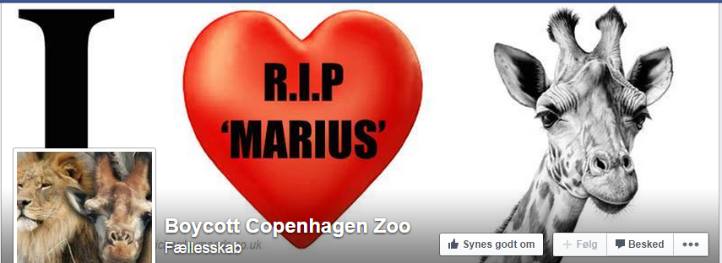
Unintended reactions
Notes:
Slide # 9 – CONCLUSION
We as information providers have an obligation to protect the people who make use of our services, but this can be pretty complicated when you deal with a tool where communication can only partly be controlled. And this leads to another very important issue. Even with the best of intentions you can’t always be sure what happens to your information once you have pressed the ‘send’ button and the reactions of the public can’t always be foreseen. I would like to finish off with an example from Facebook of what I believe is called a ‘shitstorm’, and even though it has nothing to do with cancer, I think it is very illustrative.
It all started when the staff at the Copenhagen Zoo in order to avoid inbreeding in their population of giraffes decided to kill the healthy giraffe Marius. Afterwards they invited the public to overlook the dismembering and the following feeding of the lions and tigers with the meat from the dead animal. The intent was to give people a learning opportunity and show them how things actually go on in nature.
Instead it created a public outrage that lasted for weeks, and the staff members received death threats on the social media. A Facebook page to commemorate Marius was established, the whole story went worldwide and finally the director of the zoo had to explain himself on CNN.

Slide 10
Conclusion
Social media play a central and growing role in providing cancer information and the different social media platforms have a lot to offer
However we must be aware of the vulnerabilities of the social media in regard to unintended exposure and disclosure of private information
And for years to come we will still be able to benefit from the traditional communication channels e.g. mail, online, telephone services and homepages in providing cancer information
https://www.youtube.com/watch?annotation_id=annotation_2552834439&feature=iv&src_vid=uGI00HV7Cfw&v=r5IC_jyZKJg

