Slide 1
SOURCES OF HEALTH AND CANCER INFORMATION
by Lilnabeth P. Somera
SESSION: Joining Forces through Social Media
World Cancer Congress
Melbourne, Australia, December 4, 2014

Slide 2
Pilot Project : Health Information Trends and Needs in the Pacific: A Test of Respondent-driven Sampling This research was supported by a U54 Minority Institution/Cancer Center Partnership Grant from the National Cancer Institute (Numbers: 5U54CA143727 & 5U54CA143728).  Lilnabeth P. Somera, Ph. D., University of Guam  Grazyna Badowski, Ph. D., University of Guam  Hye-ryeon Lee, Ph. D., University of Hawaii;  Kevin Cassell, Dr. PH, University of Hawaii  Megan Inada, University of Hawaii  Vejohn Torres, Dani Ramos, University of Guam  Brayan Simsiman, Alisha Yamanaka, University of Guam
Notes:
----- Meeting Notes (8/29/14 09:57) -----
patterns

Slide 3
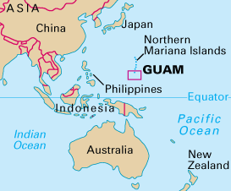
GUAM, “where America’s day begins”

Slide 4
Background
Despite improvements in the overall health of the general population, significant health disparities across diverse populations persist.
Understanding differential dynamics of communication and health behaviors in various cultural contexts is necessary to effectively address health behaviors among diverse
populations.
Data on minority and hard-to-reach populations are needed to inform cancer prevention and control program efforts.

Slide 5
Specific Aims
To collect data on cancer information-seeking behaviors as well as basic cancer-relevant knowledge, attitudes, and behaviors among populations in Guam and Hawaii in order to better inform cancer prevention and control program efforts
To test the efficacy of the respondent-driven sampling (RDS) method (Heckathorn, 2002) in generating valid population estimates and to identify a cost-efficient non-probability sampling strategy that can generate reasonable population estimates for minority and hard-to-reach populations.

Slide 6
Method
Focus group discussions to determine feasibility of using the RDS method, identify cultural factors
A survey on health communication with the HINTS instrument as the basis
Inclusion of additional items aimed at identifying cultural factors and communication practices that may influence health behaviors related to cancer risk and prevention in this population.
Administration of the survey between February and March, 2013.

Slide 7
Survey Questionnaire and Measures
The questionnaire was developed based on the Health Information National Trends Survey (HINTS).
Measures include:
How people access and use health information
How people use information technology to manage health and health information
The degree to which people are engaged in risk/health behaviors.
Cultural factors and communication practices that may influence cancer risk and prevention behaviors

Slide 8
Respondent Driven Sampling (RDS)
RDS developed by Douglas Heckathorn in 1997.
RDS is ideal for sampling “hard-to-reach” or “hidden” populations.
Peer recruitment in RDS minimizes the issue of violating participant confidentiality during recruitment.
Dual incentives are used: for participation and recruitment.
Notes:
It is a modification of snowball sampling.
As was said earlier, it is difficult to obtain participants to the study, what more when we start collecting data! Furthermore, the teens indicated that it’s best to take the survey if they were recommended by someone their age.
We used dual incentives to reward participation and to encourage participants to recruit others to the study.
----- Meeting Notes (8/29/14 09:57) -----
think about audience
ideal
slide
move recruitment coupon
remove social structures

Slide 9
Features of RDS
Similar to snowball sampling, with some modifications.
Starts with small initial convenience sample - “seeds”
Seeds are asked to recruit others – “first wave”
Respondents are asked to recruit others without identifying them.
Dual incentives are used: for participation and recruitment.
Recruitment quotas are used.
Uses special coupon system to track the recruitment process, i.e., who recruited whom.

Slide 11
RDS Data collection process
Total number of days of data collection = 23
N=511
Limiting factor – research staff

Slide 12
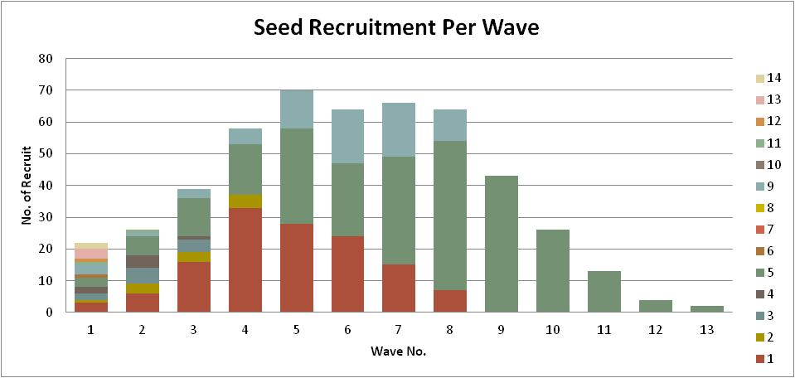
RDS results

Slide 13
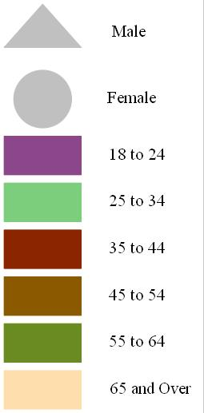
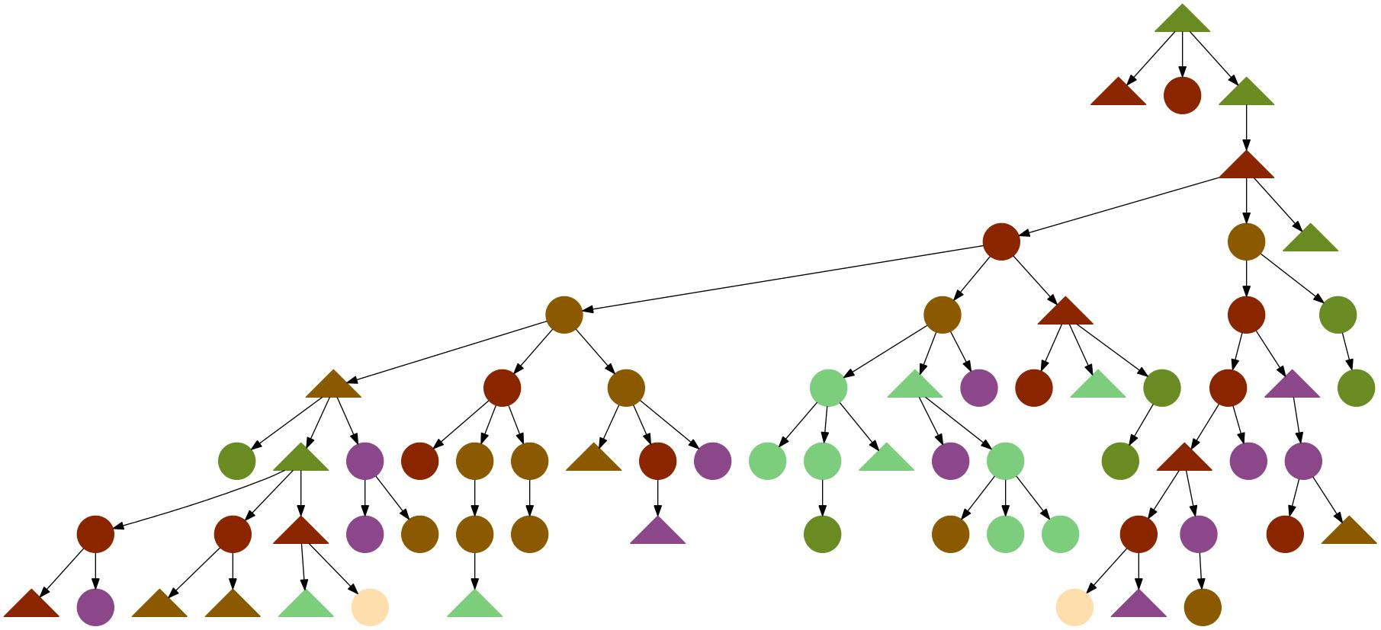
Wave patterns by age groups Seed: Male, Filipino, 57 years old

Slide 14
Demographic Comparison
 |  | 2010 Census | 2012 BRFSS | RDS
Gender | Male | 50.96 | 51.00 | 43.60
 | Female | 49.04 | 49.00 | 56.40
Age groups | 18 to 24 | 16.62 | 16.90 | 49.70
 | 25 to 34 | 19.70 | 19.60 | 17.20
 | 35 to 44 | 21.54 | 21.50 | 15.70
 | 45 to 54 | 18.94 | 18.90 | 10.80
 | 55 to 64 | 13.15 | 13.10 | 5.50
 | 65 and over | 10.04 | 10.00 | 1.20
Ethnicity | Chamorro | 35.85 | 41.10 | 52.90
 | Filipino | 29.36 | 32.10 | 31.40
 | Caucasian | 8.26 | 8.50 | 2.80
 | Asian | 7.12 | 5.60 | 3.00
 | Micronesian | 9.77 | 7.00 | 7.90
 | Other | 9.63 | 3.60 | 2.00
14

Slide 15
Information-seeking behavior

Slide 16
First choices – information source about health or medical topics
\

Slide 17
Health info seeking experience

Slide 18
Trust in information sources

Slide 19
Some implications
many similarities in health information seeking among those who live in Guam and the national U.S. sample in terms of health information seeking behaviors, as well as some interesting differences between the two populations.
reliance on health care provider as a source for health information is lower in Guam compared to the national population.
While the levels of health and cancer information seeking for the two samples are comparable, Internet use for the Guam sample is much higher. Geographical isolation for the island community may be a factor.

Slide 20
If they had a strong need for medical information, the Guam sample would first turn to the Internet, but healthcare providers are a close second choice.
There is a sharp contrast in the national HINTS data, which show that the majority would go to a healthcare provider first for an urgent need for health or medical information, followed by the Internet.
Results suggest that the choice of media could affect the effective sharing of health or cancer information.

Slide 21
Conclusions/next steps
Analysis of cultural factors which may influence the health information seeking process
Development of an intervention using mobile health channels, specifically, text messages
Another study focused on teenagers which incorporates social media in RDS recruitment.
HIPPY project
Like us on Facebook!

Slide 22
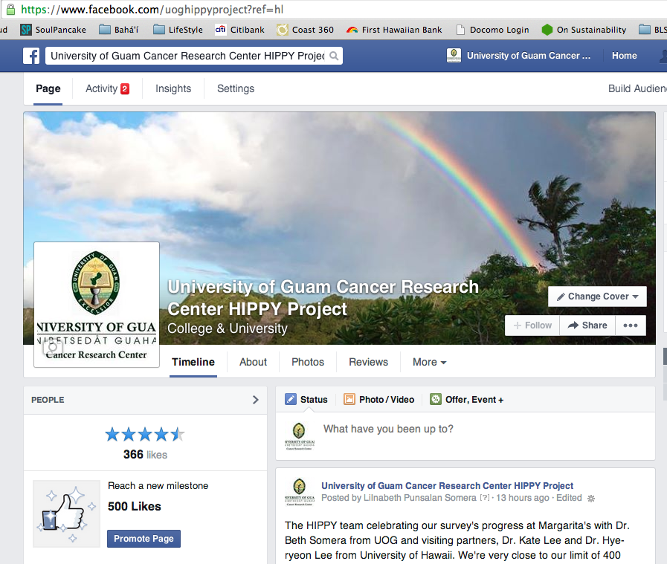
www.facebook.com/uoghippyproject
Notes:
The main purpose of the facebook was to inform participants of work site schedules.
Even with high traffic on Facebook, it didn’t translate to numbers. It became the team’s online outreach.
Majority of those who were engaging in the page were friends and family of the participants and the larger Guam community.
50% of respondents said they often log on to social networking sites
----- Meeting Notes (8/29/14 09:57) -----
break point***

Slide 23
Si yu’us ma’ase! Thank you.

