Slide 1
Audience & Channels

Slide 2
Presentation Objectives
Review National Cancer Information Center (NCIC) services and volume
Insights and learnings about cancer information provisioning and chat
Insights and learnings about cancer information provisioning and social media

Slide 3
National Cancer Information Center
Patient Resources
Cancer Information
Health Insurance Assistance
Clinical Trials Matching Service
Oncology Nurses
Donation Help
Event Support
Spanish Service
Founded in 1997
Open 24 hours a day, 7 days a week
167 cancer information specialists
13 on written communications (Chat/Email/Social Media support)

Slide 4
International
~2,570
Notes:
Channel Volume Percentage
Phone 76,2695 93.61%
Chat 29,971 3.68%
Email 19,761 2.43%
Social 6,996 0.29%
Total contacts: 819423
Social media numbers are total comments & “likes” from NCIC.
8.6% of chats last year were international.

Slide 5
Is chat an ideal channel
for cancer information provisioning?
It depends!
Successful channel for information provisioning regarding our published information
One-to-one support, similar to phones
Have experienced challenges with more than one chat at a time due to complexity of questions and systems
Notes:
-Nurse support converting to phone/email could be due to comfort levels with writing/chatting, difficulty in not having references available on cancer.org that they are sharing from…
- The majority of inquiries can be answered with general information from our medical editors, the more tailored or patient-specific information (i.e. comorbidities, previous treatment history, statistics on specific studies) are referred to our oncology nurse team.
-international inquiries convert to email instead of phone (cost)

Slide 6
Would patients and caregivers be as receptive
to using chat as donors?
Yes!
They are willing to share personal information and discuss detailed cancer information.
The majority of our chats are cancer-related now, rather than donation-related.
Notes:
-95% is 2014 average satisfaction rating- we see very high customer satisfaction in the chat channel.

Slide 7
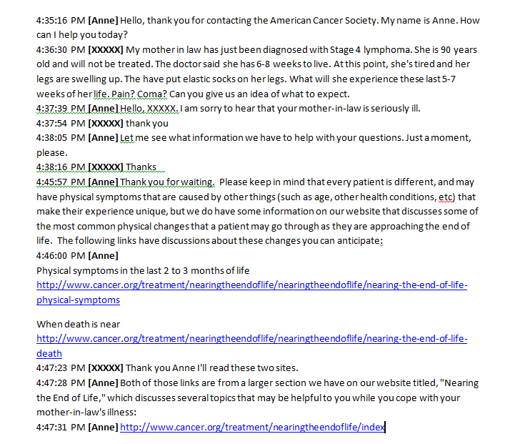
Example Caregiver CIS Chat

Slide 8
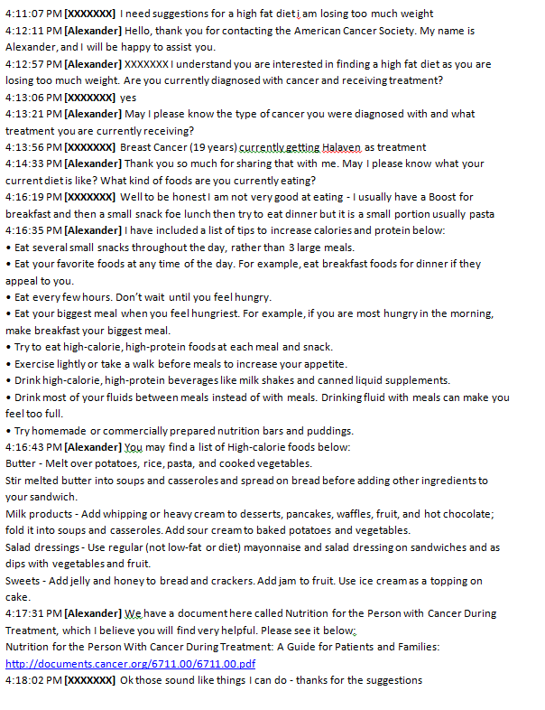
Example Patient Chat

Slide 9
Lessons learned from chat
Many chat platforms provide a transcript to the chatter
Can influence volume based on website location/ accessibility of chat link
Secure channel for private information
Health details/tailored information
Personal information for services/records
Was not effective channel for complex or rare cancer information provisioning
50% of escalated chat referrals converted to phone
Requires skilled writers
Notes:
Volume notes: We have chat on our global header, but started with it available on select pages.
Requires skillful writers- they must convey tone via words
Nurse chat had a 50% conversion rate to the phone.
- Need to be very clear that our lack of success could be due to structure or to comfort with providing written informaiton quickly on complex questions

Slide 10
NCIC Social Media Support
NCIC specialists support the Society’s national Facebook pages
Considering expansion to support Twitter and LinkedIn
One-to-many opportunity
Demographics on our 974,600+ fans:
Allows us to reach a much younger audience than chat, which is 48% 40-59 year-olds, though 77% of our chatters are also women!
Notes:
Notes on expansion to Twitter/ LinkedIn:
2nd & 3rd most active social media platforms
Considering expansion of support to these areas

Slide 11
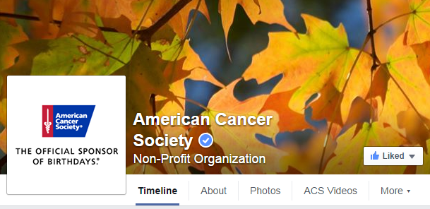
Is the Cancer Information Service
the right place for Facebook support?
Yes!
Marketing, communication, and medical departments create and post content daily, while NCIC responds to constituent comments and needs
Consistency of response across all channels
Varied hours provide better support coverage
Notes:
Varied hours- 24/7 7 days/ week
-Constituents receive responses more quickly, SPAM & promotional posts removed faster.

Slide 12
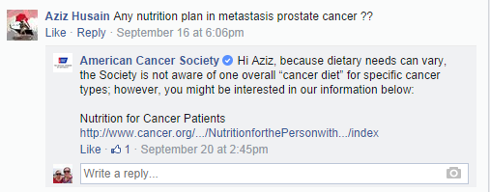
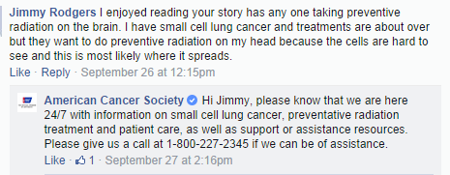
Could we address cancer information
questions in Facebook?
For the most part
Not ideal for tailored cancer information
Unsafe to share detailed personal information
Direct basic questions to cancer.org with links
Convert to another channel when too complex to simply link to cancer.org.

Slide 13
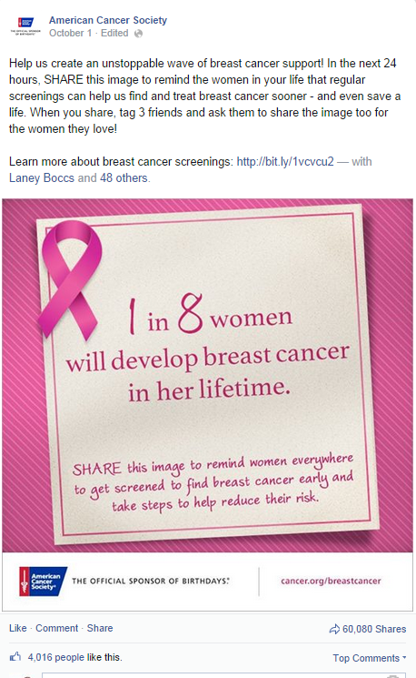
What information is best to share on Social?
Great vehicle for prevention and early detection message
Photos result in more comments
Links lead to increased click-through
Great opportunity to correct misinformation
Great for sharing ideas, thank-you messages, and engaging constituent base in dialogue with organization and each other

Slide 14
Colorectal Cancer Campaign Success
This image reached 1,067,008 people March 2014
Notes:
With over 4,000 likes and 17,000 shares reaching over 1 million people this was our most successful Facebook image from our colorectal cancer awareness campaign March 2014. You can see the link to our information on early detection in response to one of the many comments on the image.

